Slide 1

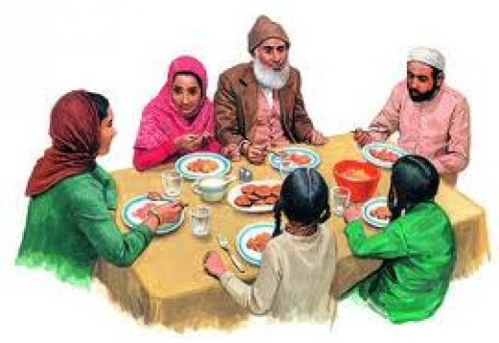
Muslim Eating Etiquettes and Manners.
Info taken from talibdeen jr.

Slide 2
How a Muslim eats
Narrated By 'Umar bin Abi Salama
I was a boy under the care of Allah's Apostle and my hand used to go around the dish
while I was eating. So Allah's Apostle said to me, 'O boy! Mention the Name of Allah and
eat with your right hand, and eat of the dish what is nearer to you." Since then I have
applied those instructions when eating. (Bukhari)

Slide 3
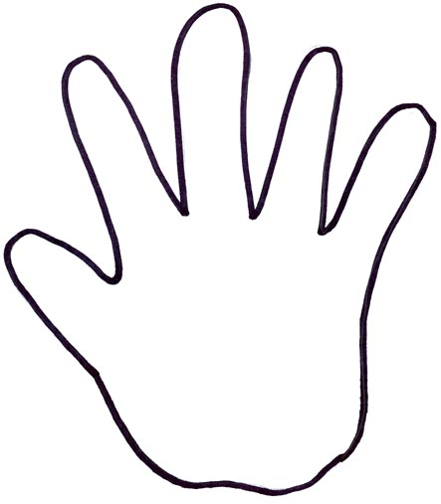
Activity
What do we say when we start eating? Bismillah hirrahman nirraheem
Trace your right hand on a paper and color it.

Slide 4
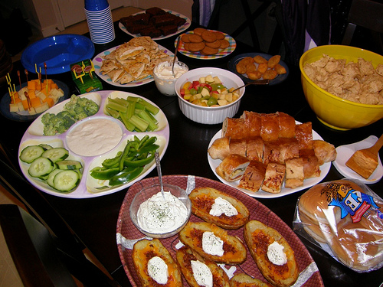
What will you pick first if you are…?

Slide 5
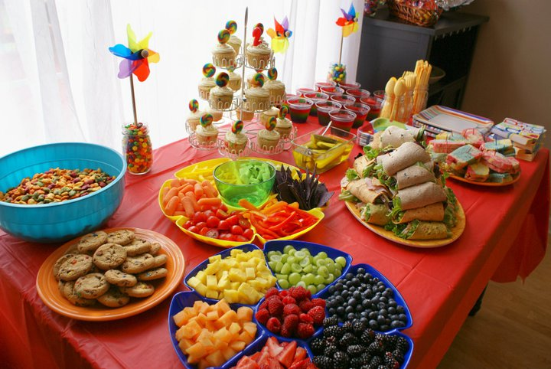
What will you pick first if you are…?

Slide 6
Activity
Draw your favorite food.
What will you say when you eat it ?
What hand will you use to eat it?
Teacher please ask each child question 2 and 3 when you check their drawings

Slide 7
By Umm Momina

