Slide 1

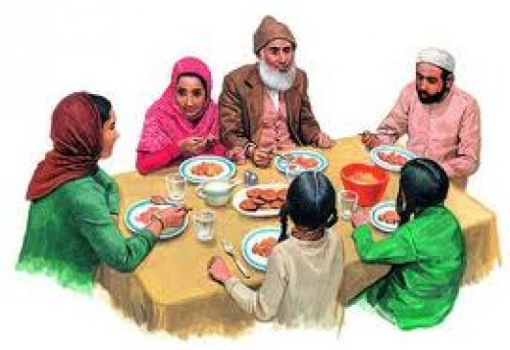
Muslim Eating Etiquettes and Manners 2
Info taken from talibdeen jr.

Slide 2




What happens if you don’t say Bismillah before eating?
The Shaytan eats with you.
Narrated By Umayyah Ibn Makhshi:
Umayyah was sitting and a man was eating. He did not mention Allah's name until there remained the last morsel. When he raised it to his mouth, he said: In the name of Allah at the beginning and at the end of it.
The Prophet (salla Allahu alayhi wa sallam) laughed and
said: “The devil kept eating along with him, but when he mentioned Allah's name, he vomited what was in his belly.” (Abu Dawud)

Slide 3
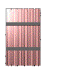
What happens if you don’t say Bismillah before eating?
Jabir b. 'Abdullah reported Allah's Messenger (may peace be upon him) as saying: When a person enters his house and mentions the name of Allah at the time of entering it and while eating the food, Satan says (addressing himself: You have no place to spend the night and no evening meal; but when he enters without mentioning the name of Allah, the Satan says: You have found a place to spend the night, and when he does not mention the name
of Allah while eating food, he (the Satan) says: You have found a place to spend the night
and evening meal. (Muslim 5006)

Slide 4
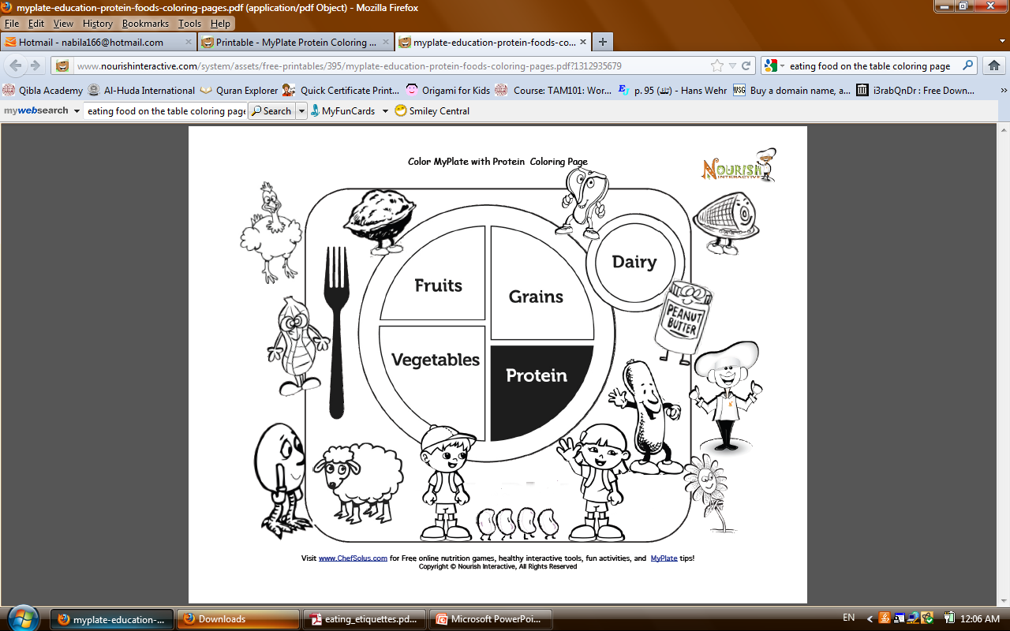
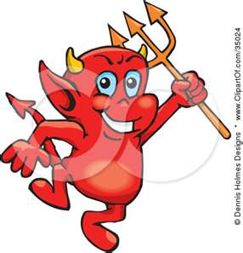
Activity- Color !
What happens if you don’t say bismllah?
My plate

Slide 5
By Umm Momina

