Slide 1

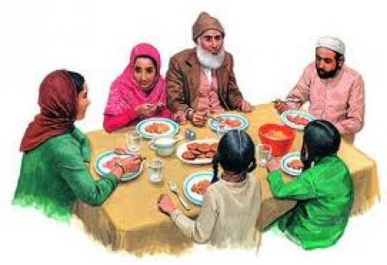
Muslim Eating Etiquettes and Manners 2
Info taken from talibdeen jr.

Slide 2
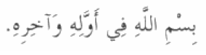
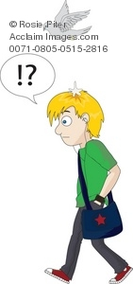
What do you say when you forget to say Bismillah before you eat?
Bismillahi Fee awwalihi wa akhrihi
In the Name of Allah in its beginning
and end. (Abu Dawud)

Slide 3
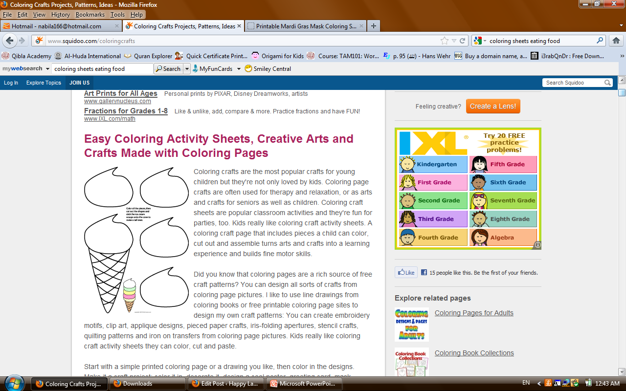
Activity
Cut and Paste Ice Cream

Slide 4
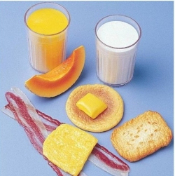
Good breakfast?
What do you say when you forget to say Bismillah before you eat?
Bismillahi Fee awwalihi wa akhrihi
In the Name of Allah in its beginning
and end. (Abu Dawud)

Slide 5
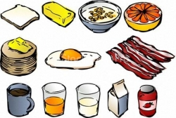
Activity
Draw a circle around what you eat for breakfast

Slide 6
By Umm Momina

