Slide 1
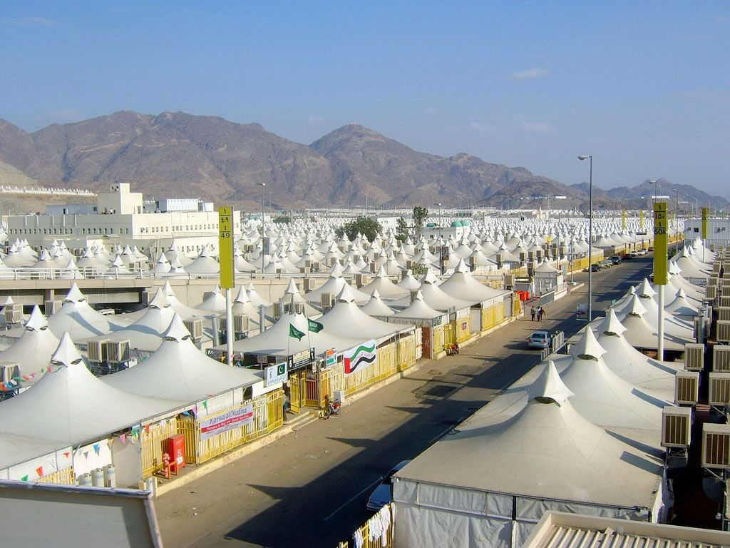
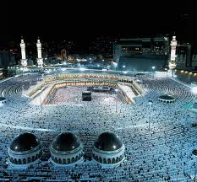
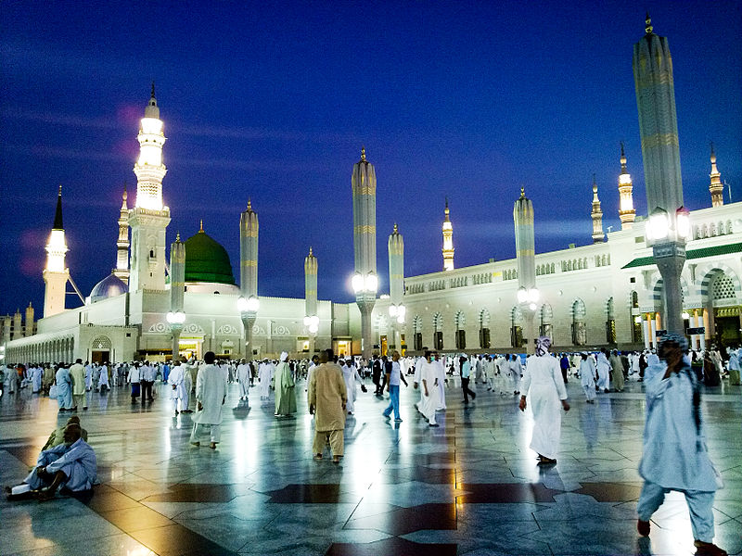
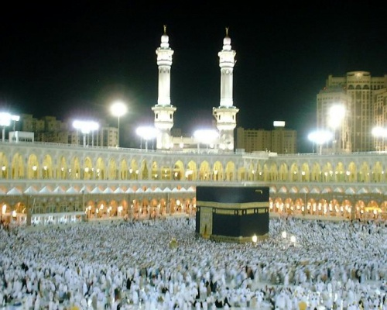
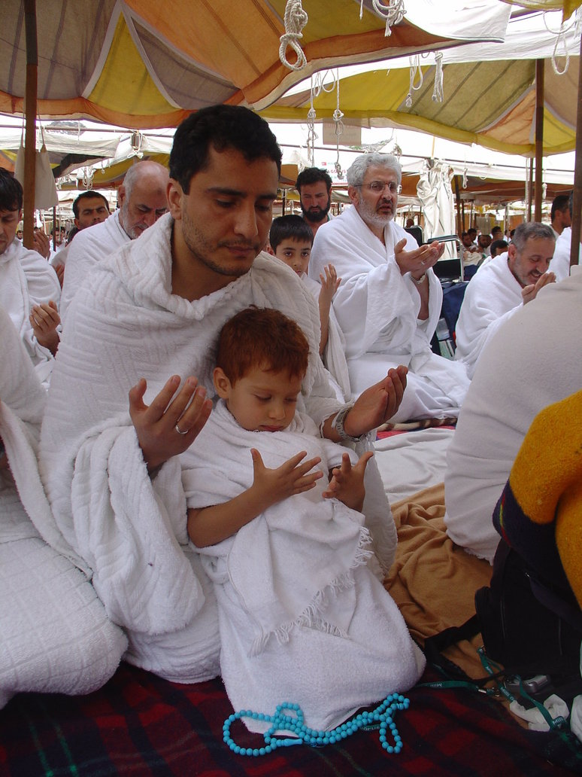
Hajj-E-Project
By Fawad

Slide 2
The 3 kinds of Hajj
THE 3 KINDS OF HAJJ
Hajj--E-Qiran
Hajj—E-Ifrad
Hajj—E Tammutu
Notes:
There is automatic loops in the slide show so don’t click on anything

Slide 3
Hajj—E-Tamattu
Hajj—E-Ifrad
Umrah is before Hajj
There should not be slaughter after Umrah
Abandon ihram after Umrah
Resume Ihram on the 8th of Zul-Hijja
Hajj and umrah in 2 parts.
Hajj—E-Qiran
Hajj and Umrah is combined
They could or could not be animal sacrifice.
Ihram is worn throughout
Intention of Hajj
Hajj without Umrah

Slide 4
Hajj Step by Step Summary
Ihram- الاحرام
Mina ( at the day of Dhul Hijjah 8) منى
Arafat(Dhull Hijjah 9) عرفة
Muzdalifa (Dhull Hijjah 9-night)مزدلفة
Mina(Dhul Hijjah 10) منى:
Ramy(throw pebbles at Jamarat Al`Agahbah
NaHr(sacrifice)
Halq (shave hair of the head)
Makkah (Dhul Hijjah 10) مكة المكرمة:
Tawaf-Al-IfaDah
Sa`y between Sarfa and Marwa
Mina(11 12 and 13 Dhul Hijjah) منى :
Ramy(throw pebbles at all three jamaraat)
Makkah(last day)
Tawaf Al Wada’ (farewell Tawaf)

Slide 5
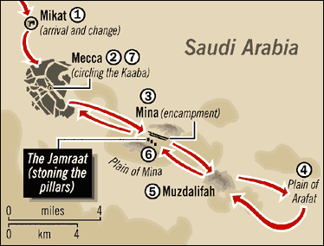
Route Map of Hajj
Ihram for Hajj
If you are coming outside from outside like from Europe of Africa, assume Ihram at or before the Meeqat.
If you are in the limits of the Haram of Makkah but outside, where the Ihram from your place.
If you are inside the Haram of Makkah, wear Ihram from your place as well.

Slide 6
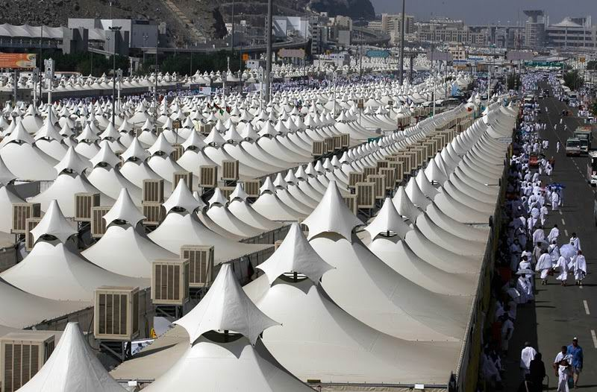
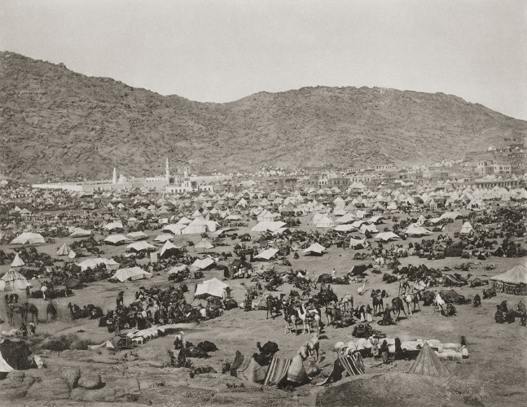
Mina-Dhul Hijjah 8
Go to Mina in the morning of Yaum at-Tarwiyah(8th of Dhul-Hijjah).
Pray Dhuhr,Asr,Maghrib,Isha and Fajr in their times with qasr (shortening Dhuhr, Asr and Isha to 2 Raka`at.
Spending this night in Mina is a sunnah.
Use your time to gather your thoughts and prepare for the next day.. the day of Arafat.

Slide 7
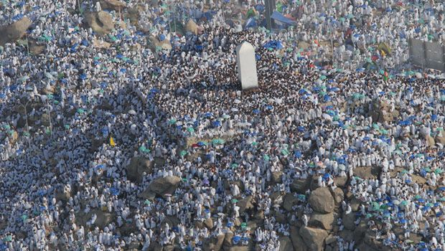
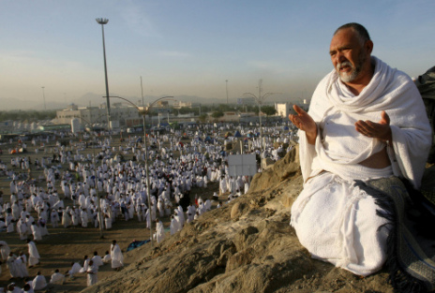
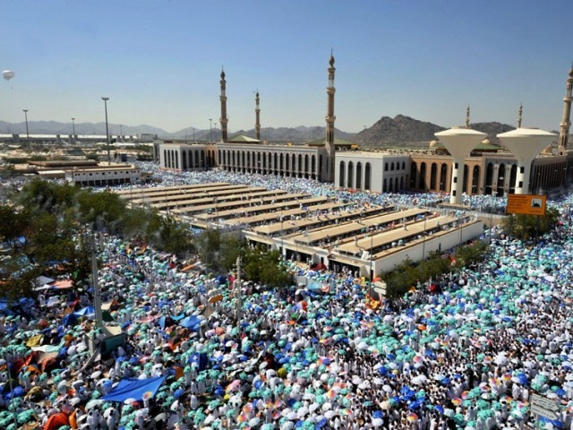
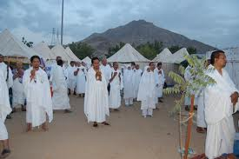
Arafat-Dhul Hijjah 9
After sunrise on the day of Arafat, depart for Arafat while making Talbiyah or Takbeer.
The Prophet Muhammad S.A.W (P.B.U.H) said, There is no day on which Allah frees more of His slaves form Fire than the day of Arafat, He draws near, then praises them before the angles, saying: What do they seek?
And said, Hajj is Arafat
Pray Dhuhr and Asr at Masjid Namira(if possible or pray or your camp), 2 rak’at each, combined at the time of Dhuhr, after listeing to the Imam’s sermon.
When the sun has set you leave Arafat for Muzdalifah going with calmness, not pushing people.

Slide 8
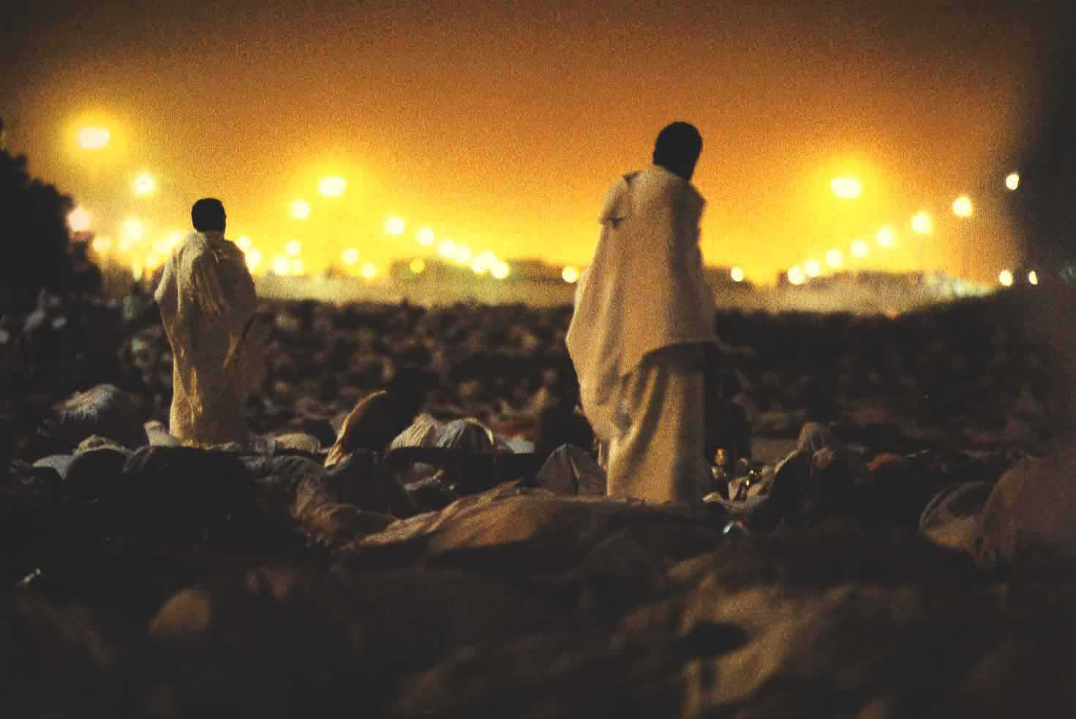
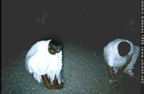
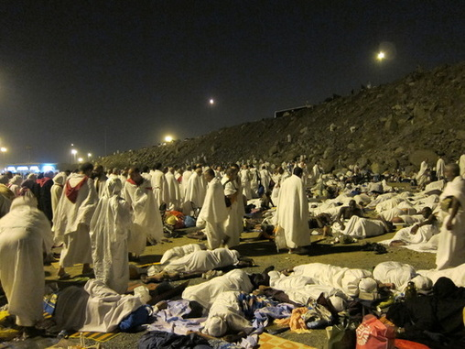
Muzdalifah-night of Dhul Hijjah 10
When reaching Muzdalifah pray Maghrib then Isha shortening is(qasr) and joining the two prayers.
You do not pray anything between them or after Isha, but always pray Witr.
You may collect pebbles here.
Then you sleep until Fajr
Pray Fajr at the beginning of its time.

Slide 9
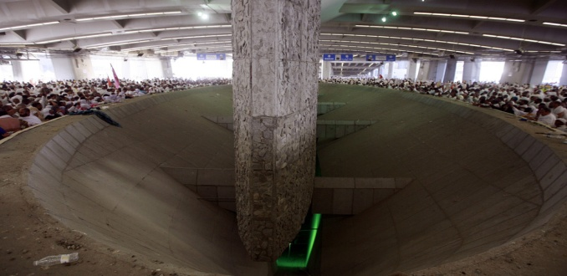
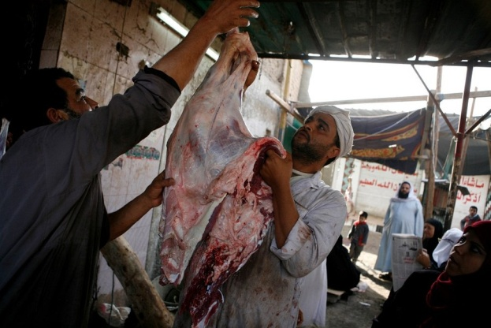
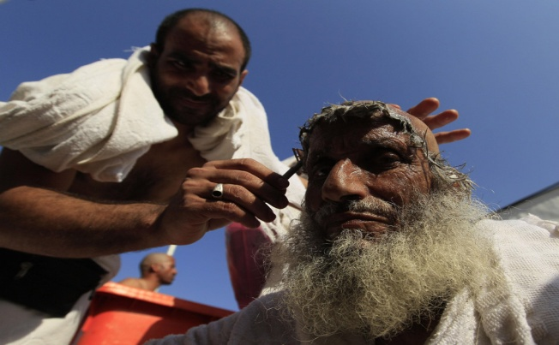
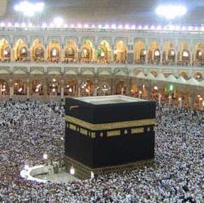
Back to Mina-Dhul Hijjah 10
You arrive to Mina the morning of the 10th of Dhul Hijjah.
This is the busiest day of the Hajj. You will be doing:
Stone Jamrat al-’Algabah
Sacrifice an animal
Shave or trim off your hair
Go to Makkah to do Tawaf al-Ifadah & come back to Mina

Slide 10
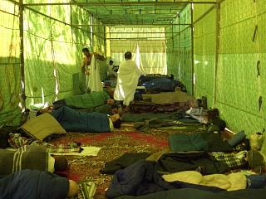
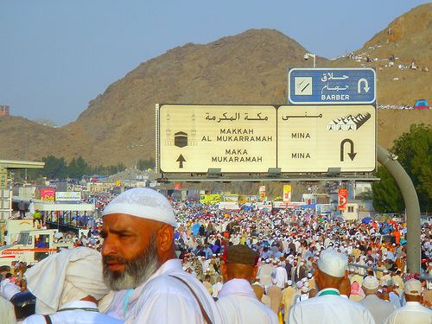
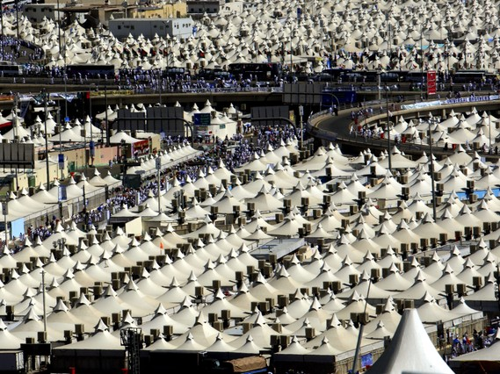
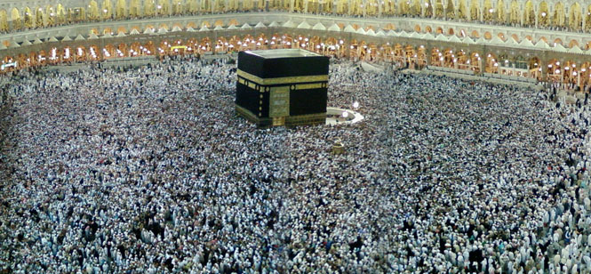
Mina-11,12,13 Dhul Hijjah
Stay in Mina for the days of Tashreeq and their nights.
Ramy
Stone the three Jamarat each with seven pebbles in each of those days.
Leaving Mina
You may leave Mina before sunset if you wish after you perform the Ramy on the 12th of Dhul Hijjah or stay to perform the Ramy on the 13th.
After you finish the Ramy on the 12th or 13th of Dhul Hijjah, you have completed your Mansik.
You go to Makkah and stay there.
Make nafl Tawaf as much as possible
Drink Zamzam water and carry with you for your country.
May Allah accepts everybody’s Hajj
Ameen

