Slide 1

The Prophet’s (pbuh)
Family Tree

Slide 2
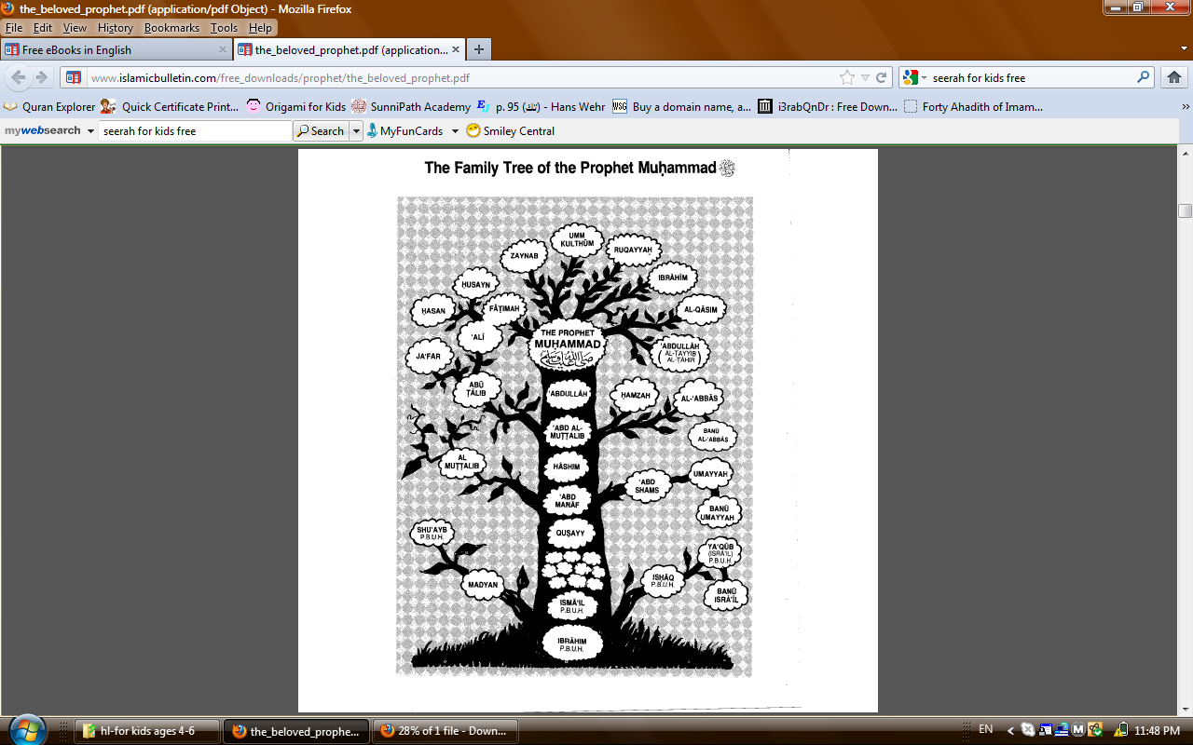

Slide 3

Activity 1
Draw or print this tree and
List the Prophet’s (pbuh) children
4.
3.
5
2.
6.
1.
7.

Slide 4

Activity 2
Draw or print this tree and
List the Prophet’s (pbuh) ancestors
The Prophet Muhammad (pbuh)
1.
7.

Slide 5
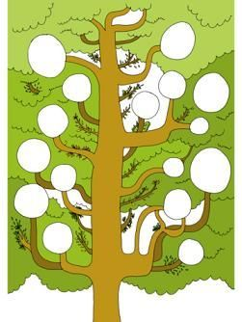
Activity 3
Draw or print this tree and
List the Prophet’s (pbuh) ancestors and uncles
MUHAMMAD
(PBUH)
The Prophet
Muhammad (pbuh)
IBRAHIM
(PBUH)
ancestors
uncles

Slide 6

Activity 4
Draw or print this tree and fill the boxes with the names of the Prophet’s (pbuh)
Father and Mother (write in red)
Daughter Fatima and her family.
(write in blue)
His (pbuh) daughters.
(write in green)

Slide 7
By Umm Momina

