Slide 1

The Prophet Muhammad*
The Prophet Muhammad was born in Makkah, a town in Arabia, early on a Monday on the 12th of Rabi-al-Awwal more than 1,400 years ago. It was in the year 570 of the Christian Era (CE).

Slide 2
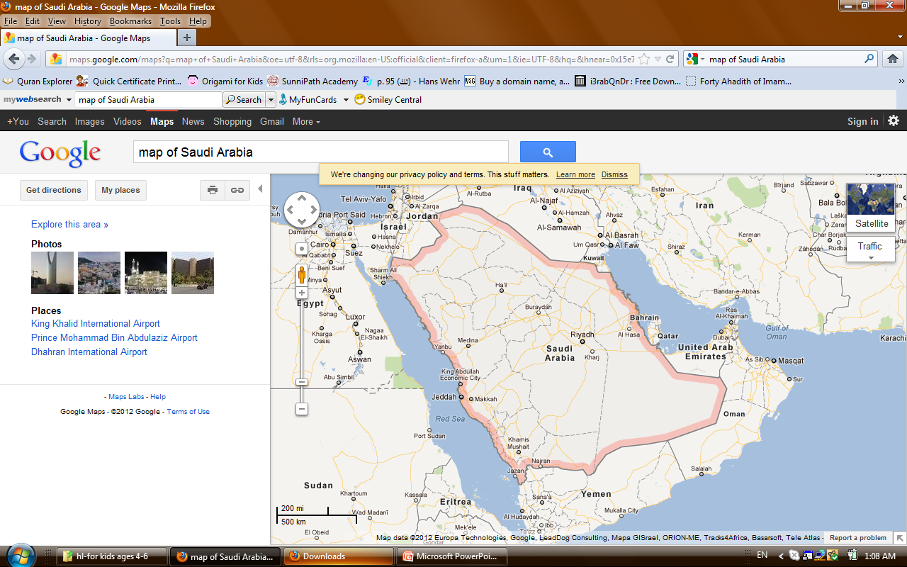
Find Makkah!

Slide 3

'Year of the Elephant'
That year was called Am-al-Fil or the 'Year of the Elephant'. At that time, Abraha, the Governor of Yemen, had invaded Makkah intending to demolish the Ka'ba. He arrived, together with his troops, on elephants.
Abraha had set up a mock Ka'ba in Yemen and he wanted people to visit this one instead of the Ka'ba of Allah in Makkah.

Slide 4
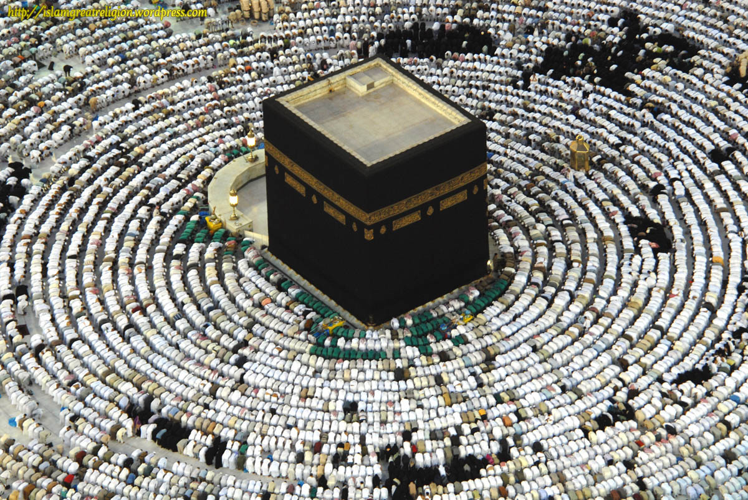

Slide 5
Allah sent flocks of birds to fly over the invaders.
Each bird carried a pebble of clay.
They dropped the pebbles from high up in the
sky onto the invaders until all the soldiers and elephants were destroyed.
Abraha fled back to Yemen, but he could not escape the wrath of Allah. Soon afterwards he died a very painful death. This story is told in the Qur'an in Sura al-Fil (105).

Slide 6
Where and when was the Prophet (pbuh) born?
What is the ‘Year of the Elephant’?
Who was Abraha and what happened to him?
In which Surah of the Holy Qur’an the story of the Elephants is mentioned?

