Slide 1

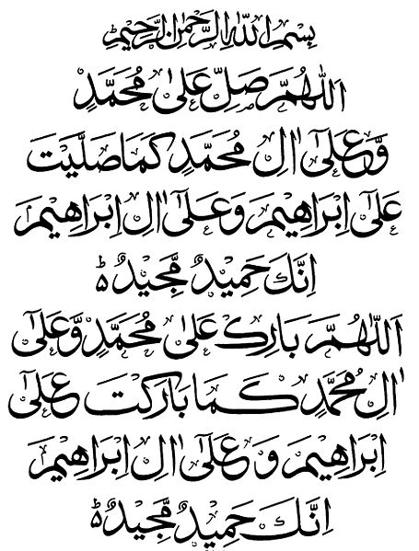
My Seerah Book Project
ALLAHUMMA SALLI ALA MUHAMMADIW
WA ALA AALI MUHAMMADIN
KAMAA SALLAITA
ALA IBRAHIMA
WA ALA AALI IBRAHIMA
INNAKA HAMIDUM MAJID.
ALLAHUMMA BAARIK ALA MUHAMMADIW WA ALA AALI MUHAMMADIN
KAMAA BAARAKTA
ALA IBRAHIMA
WA ALA AALI IBRAHIMA
INNAKA HAMIDUM MAJID.

Slide 2

Activity 1.
Draw the front cover of your Seerah Book
My Seerah Book-page 1

Slide 3
By Umm Momina

