Slide 1
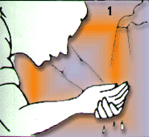
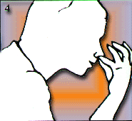
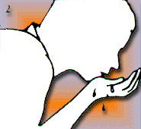
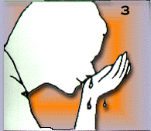
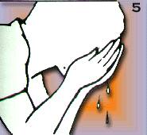
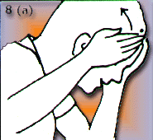
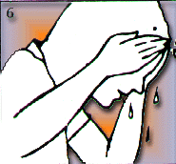
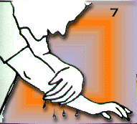
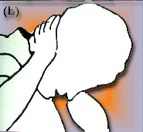
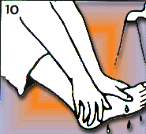
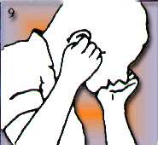
Wudu

Slide 2
Wudu
Wudu, the ritual washing in preparation for prayer, can be performed anywhere, but very often is performed in a bathroom. Mosques have a special area, separate from the toilets, where wudu is performed.

Slide 3
Wudu
Before performing Wudu Muslims will need to make their intention to wudu by clearing their minds and saying “Bismillah”
Translated this means
"In the name of Allah”

Slide 4
Step 1
Wash your hands to your wrists three times, right hand then left hand making sure you wash between your fingers.

Slide 5
Step 2
Put a hand full of water in your mouth and rinse it thoroughly three times.

Slide 6
Step 3
Step 4
Sniff water into your nose three times and then wash the tip of your nose.

Slide 7
Step 5
Step 6
Wash your face three times from right ear to left ear and from the forehead to the throat.

Slide 8
Step 7
Wash your right arm then your left arm thoroughly from the wrist up to the elbow three times.

Slide 9
Steps 8 a & b
Move wet palms over the head from the top of the forehead to the back of the head.

Slide 10
Step 9
Steps 8 a & b
Clean the inside and outside of both ears including behind the ears.

Slide 11
Step 10
Steps 8 a & b
Finally, wash both feet up to the ankles making sure that you wash between the toes and all parts of the feet.

Slide 12
At the end of the steps recite:
“ash-hadu an la ilaha illal lehu wa ash-hadu anna Muammadan ‘abduhu was rasuluah”
Translated this means:
I testify that there is no God but Allah and he is One and has no partner that Muhammad is His servant and messenger.

Slide 13
Wudu - Golden Rules
Every bit of skin on the face, forearms and feet need to have touched water for Wudu to have been performed properly.
Make sure all steps are performed in the right order.
Do not interrupt the Wudu. If you stop the wudu you will have to start the steps again.

Slide 14
Nawaqid-i-wudu: Things break the wudu (Nawajis-breakers)
Answering the call of nature (defecation, Gas, Urination, Emissions)
Passing the water, Wind
SLEEP/Dozing off while lying/ sitting/ standing/leaning against a support
Sleep/Dozing during Salat/reading Quran
Unconsciousness/Fainting
Injury
Drainage of Pus, Blood Drawing/Bleeding-passing
Vomiting-mouthful
Laughing aloud whilst in Salat.
HYPER-Insane/Madness screaming
Satar, Shaving hair, finger-nails

Slide 15
LO: to know about Wudu and what it means in practice.
Task:
Design an information leaflet explaining and illustrating the practice of Wudu. Include an explanation of what Wudu is and the three golden rules.

