Slide 1
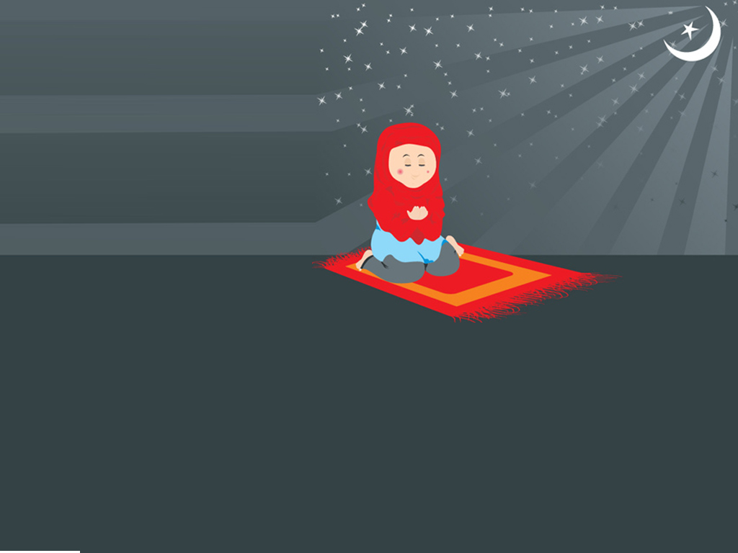
FASTING

Slide 2
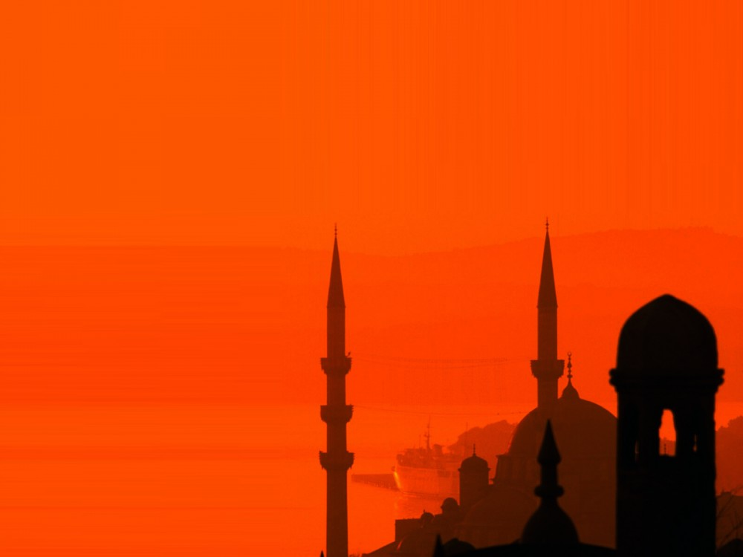
Who remembers the five pillars?
Zakat (Giving money)
Shahadah
Prayer
Hajj
Fasting

Slide 3

Fasting is when we don’t eat food until the sun goes down!
All muslims fast in RAMADAN

Slide 4

WHY?

Slide 5
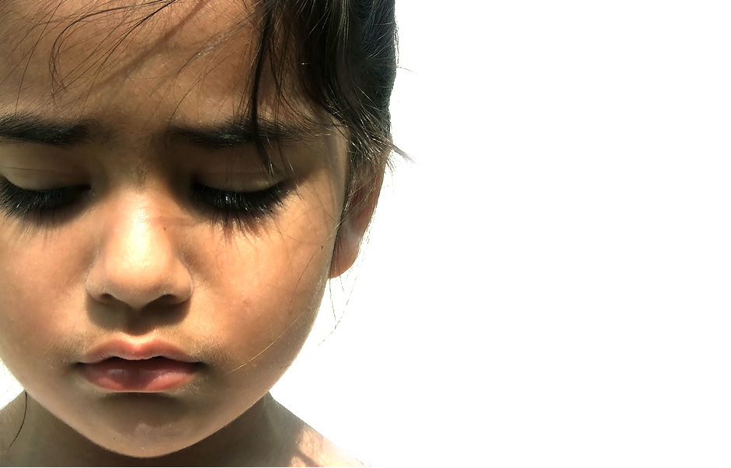
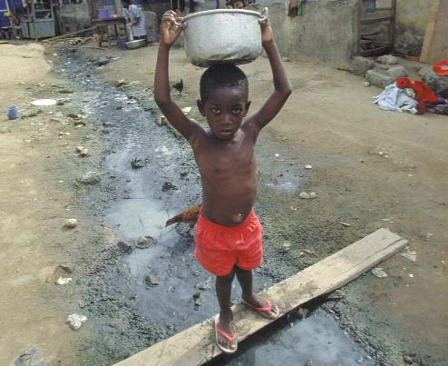
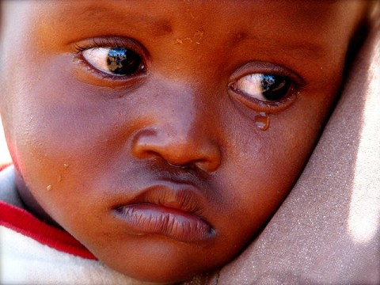
We FAST because it gives us the feeling of what other people who don’t have food go through.

Slide 6

Fasting also teaches us to be very thankful for what we have.

Slide 7
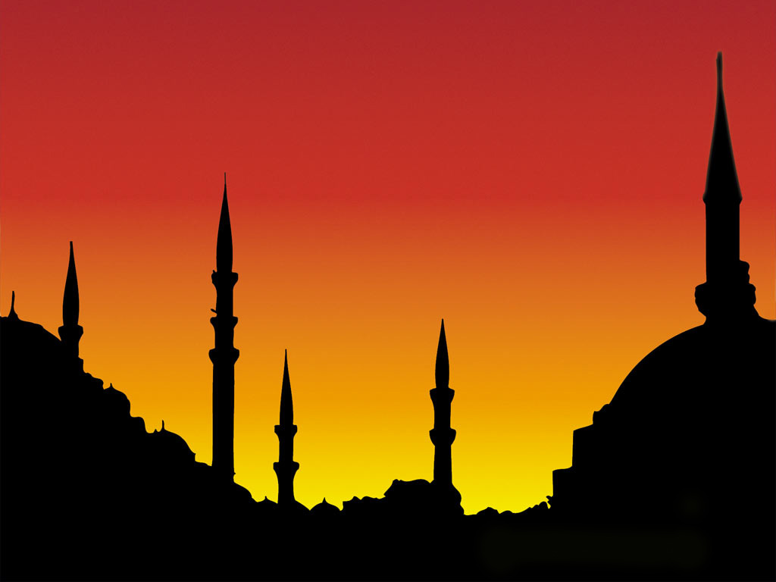
We will all keep a very small fast today.
Our lunch will be at the end of the day!

