Slide 1

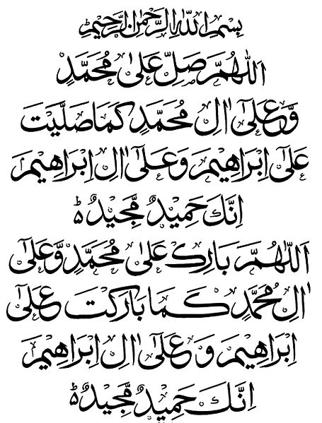
My Seerah Book Project
ALLAHUMMA SALLI ALA MUHAMMADIW
WA ALA AALI MUHAMMADIN
KAMAA SALLAITA
ALA IBRAHIMA
WA ALA AALI IBRAHIMA
INNAKA HAMIDUM MAJID.
ALLAHUMMA BAARIK ALA MUHAMMADIW WA ALA AALI MUHAMMADIN
KAMAA BAARAKTA
ALA IBRAHIMA
WA ALA AALI IBRAHIMA
INNAKA HAMIDUM MAJID.

Slide 2
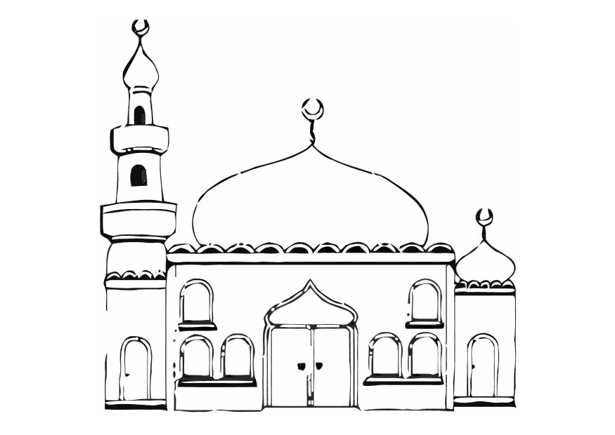
Activity 2
.
The Prophet Muhammad (peace be upon him) used to pray fajr prayer at the mosque.
Draw or print the picture and then color it.
My Seerah Book-page 2

Slide 3
By Umm Momina

