Slide 1

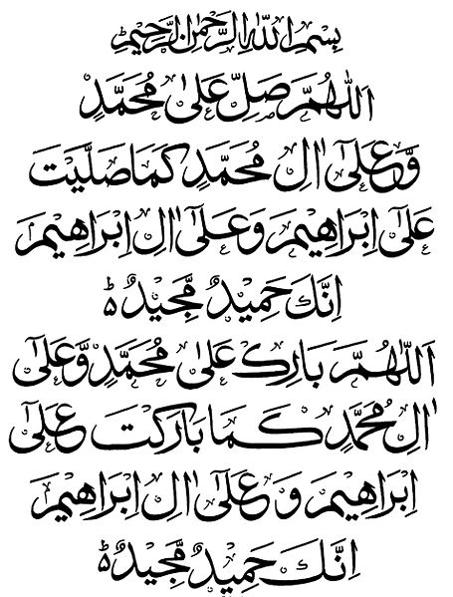
My Seerah Book Project
ALLAHUMMA SALLI ALA MUHAMMADIW
WA ALA AALI MUHAMMADIN
KAMAA SALLAITA
ALA IBRAHIMA
WA ALA AALI IBRAHIMA
INNAKA HAMIDUM MAJID.
ALLAHUMMA BAARIK ALA MUHAMMADIW WA ALA AALI MUHAMMADIN
KAMAA BAARAKTA
ALA IBRAHIMA
WA ALA AALI IBRAHIMA
INNAKA HAMIDUM MAJID.

Slide 2
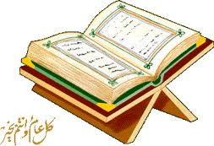
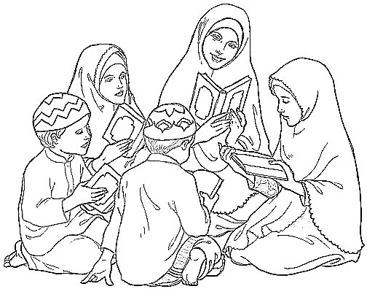

After Maghrib The Prophet (pbuh) used to give time to ladies. He (pbuh) used to teach them and answer their questions.

Slide 3
By Umm Momina

