Slide 1
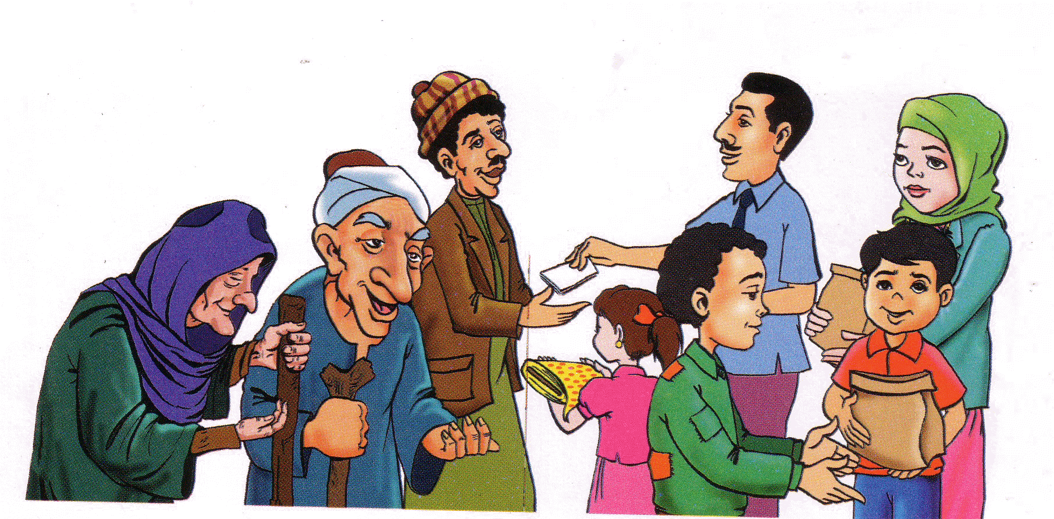
ZAKAT

Slide 2
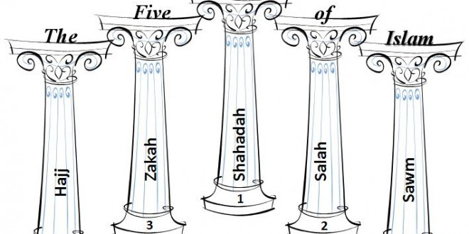
Who can tell me the 5 things Muslims must do?

Slide 3
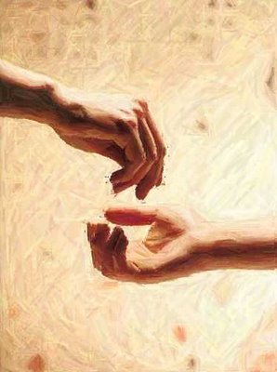
What is zakat?
It is when you give
money to Muslims
who do not have money.

Slide 4

WHY?

Slide 5

So Allah will be happy with us and give us Jannah (Pardaise)

Slide 6

How do we know there is a paradise?

Slide 7
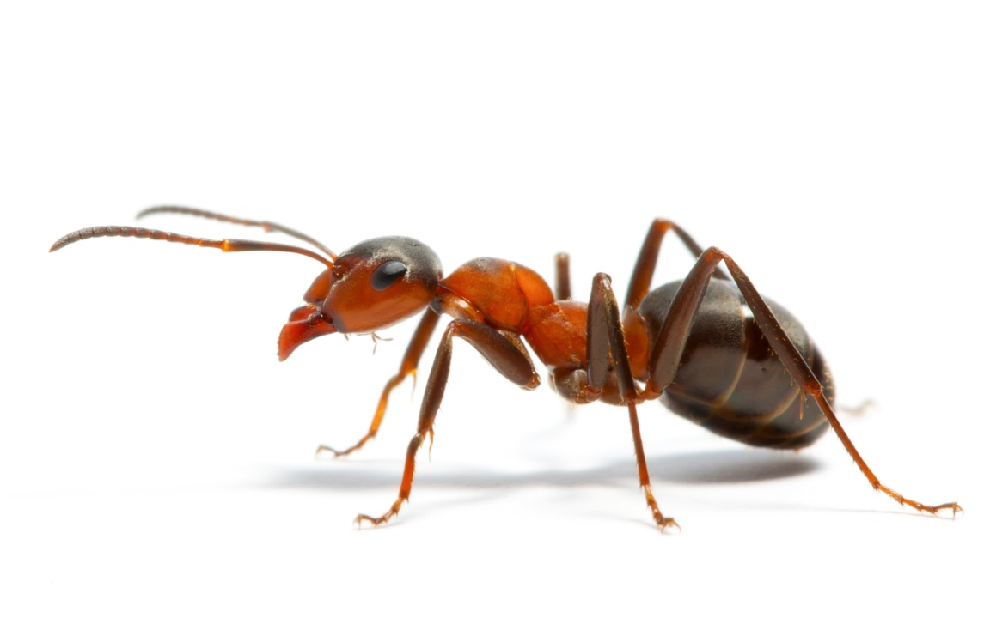


Can we make a tree?
Can we make an ant?
Can we make a piece of grass?
Only someone with AMAZING
powers can make these things. Only Allah can make these things.

Slide 8

Allah told us there is a paradise. So if Allah can make an ant and trees then Allah can defiantly make paradise.

