Slide 1


Slide 2

Surah Al Baqarah
Juzz 1
Class notes
Verses 49-59

Slide 3
Al Baqarah Ayah 49-59
In the following verses we will come to know more about the blessings, attitude, trials and punishments of Bani Israel.
Bani Israel were the children of Prophet Yaqub. Prophet Yaqub had 12 sons. His eldest son was Yahuda and Bin Yameen was his youngest son. Prophet Yusuf was also the son of Prophet Yaqub.
Prophet Yaqub was from Kinaan (Palestine). He reached Egypt because of his son Prophet Yusuf. Bani Israel moved to Egypt with him. They lived a prosperous life in Egypt for many years. After many years a king of Egypt, who loved to construct buildings enslaved them. Bani Israel had become corrupted and weak, their iman had weakened and they had become disobedient to Allah (swt).
Allah (swt) sent Prophet Musa and Prophet Harun to save Bani Israel from the hardships.
Verses 49-59

Slide 4
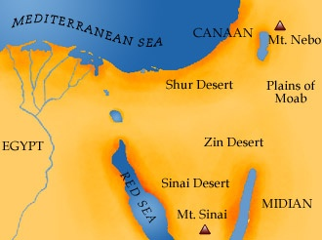
Allah (swt) helped Bani Israel cross the sea from Egypt to Desert Sinai. Prophet Musa left them their for 40 days. He went to get Tawrah on the Mount. In his absence they started to worship a calf.
Allah (swt) got angry with them and they had to wander in the same desert for 40 years. They wandered in the Plain of Teen.
Prophet Musa and Harun died in this period. A disciple of Prophet Musa, Yushay bin Nun was granted prophet hood and he took Bani Israel to Kinaan (Palestine).
Verses 49-59

Slide 5
Allah (swt) helped Bani Israel cross the sea from Egypt to Desert Sinai. Prophet Musa left them their for 40 days. In his absence they started to worship a calf.
A man called Samri build a calf for them and encouraged them to worship it. Allah got angry with them and they had to wander in Plains of Zin for 40 years. Prophet Musa and Harun died there and a disciple of Prophet Musa, Yushay bin Nun managed to take Bani Israel to Kinaan (Palestine).
Bani Israel were blessed with provisions and prophets. Allah (swt) sent many messengers such as Prophet Daud and Prophet Sulayman to Bani Israel.
Verses 49-59

Slide 6
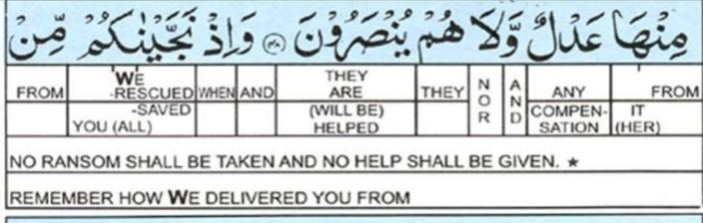
Idh means when. It can be the short for idhkuru.
It may be used to remind of something that has happened in the
past or when something had happened suddenly.
In the Quran, the word idhā (إذا) is frequently used as a conditional particle and is usually translated as "when". The pseudo-syntax for this type of temporal conditional sentence is: when <condition> then <result>
In verse 49, Allah (swt) is reminding Bani Israel how He saved them from the torture of Firawn who used to slaughter their sons.
Verse 49

Slide 7
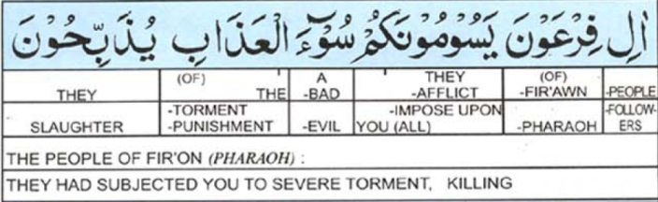
Yasoomuna comes from “soom” which means to cause pain.
Literally it means to follow ones desire, to trouble or force someone.
Yudhabi una comes from “dhaba” which means to kill. To kill with planning and torture.
In this verse it’s the torture Bani Israel went through when their sons were slaughtered in front of them.
Bani Israel were facing the torment from Firawn.
Nations who fail to fight for their rights and go astray suffer until they change their ways.
Verse 49

Slide 8
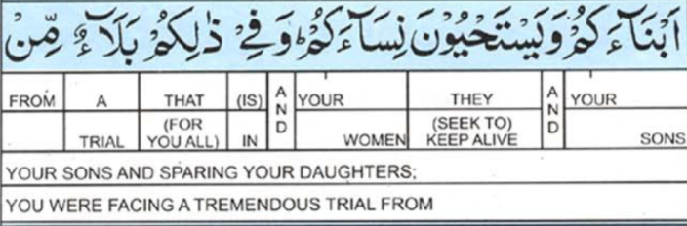
Yustahyouna.
When this word is from the word “haya” it means to feel ashamed.
When this word is from the word “hayaat” it means to let live.
It is said that Firawn once dreamt that someone from Bani Israel would kill him. So he ordered the killing of the sons of Bani Israel. Another reason for this killing was that he did not want Bani Israel to increase in number. According to his commands they boys were killed one year and in the other year they were not killed. This is one reason why Prophet Harun was saved from being killed. The girls of Bani Israel were made slaves. It was a great trial for Bani Israel.
Verse 49

Slide 9
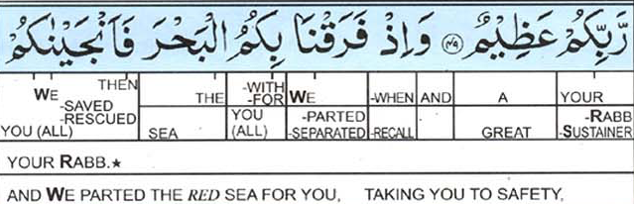
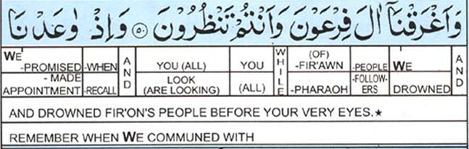
Allah (swt) then helped Prophet Musa part the sea . Musa raised his staff and the sea opened a way for Bani Israel to escape from the army of Firawn. Red Sea is called bahr-i kulzum
بحر قلزم
Verse 50

Slide 10
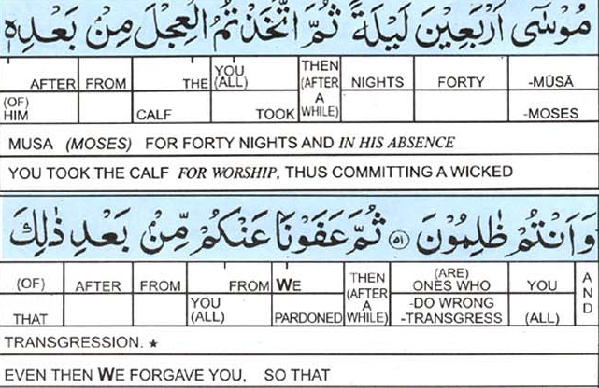
Allah (swt) called Musa to Kuh e Tur for 40 nights. Why nights? This is because according to the Arabs night comes before the day. The day begins with the sighting of the Moon.
Allah (swt) says that Bani Israel were Zalimun as they did Shirk. They had started to worship a calf. Allah (swt) forgave them .
Verse 51

Slide 11
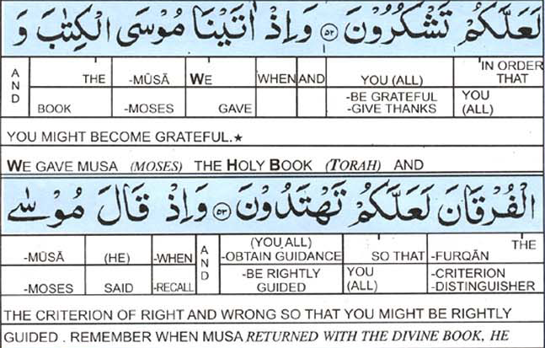
Allah (swt) gave Musa Tawrah on Koh e Tur.
Tawrah is a group of first five books of Old Testament.
Furqan here means:
The distinguisher, miracles of Musa, Tawrah.
Tawrah was sent as a guide for Bani Israel.
Verses 52-53

Slide 12
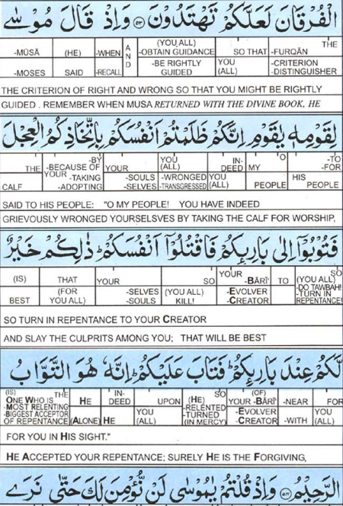
As a punishment for their “zulm” (shirk) Prophet Musa asked Bani Israel to seek pardon from Allah (swt) by killing those who did shirk. The believers were told to kill the disbelievers.
From verse 52 we learn a very important point about repentance and that is that there are many forms of repentances..
Let us first remember the three conditions for repentance (tawbah)
To be ashamed of what one has done in the past.
To leave the bad deed.
To promise not to repeat the sin again.
Verses 53-54

Slide 13


We learn from different verses of Qur’an that there are different forms of repentances.
There are some deeds that wash away one’s sins. Such as when when one prays, does wudhu or does ahsaan. This is like the washing away of dust from the atmosphere when it rains. In the same way little sins are washed away by good deeds.
Then there are sins for which one has to seek Allah (swt) foregiveness.
There are sins for which one has to pay a penalty (kafaarah). Such sins are usually because of ones irresponsible attitude towards fellow human beings (haqooq ul ibaad). As Allah (swt) has said that He may forgive some sins done against Him but will never forgive if one has harmed his fellow beings until they forgive him.
There are sins for which one has to face punishment. Such as adultery, stealing. The sin committed by Bani Israel when they worshipped the calf was shirk and for that they were punished. The believers had to kill the disbelievers. It was only after the punishment was executed that Allah (swt) forgave Bani Israel.
Verse 54

Slide 14
Hadith on Shirk
Abu Bakr (radiyallahu anh) related that Rasulullah (sallallaahu alayhi wa sallam) said: “Shirk amongst you is more hidden than the crawling of an ant, and I shall tell you of something which, if you do it, will remove from you both the minor and the major Shirk. Say: Allahumma inni a’udhu bika an ushrika bika wa ana a’lamu wa astagh-firuka limma laa a’lam (O Allah, surely I seek refuge in you from knowingly worshiping others besides you and I seek your forgiveness for what I don’t know).” (Sahih al-Jaami)
To be safe from shirk one must know what shirk is and that can only be achieved through knowledge.
Verse 54

Slide 15
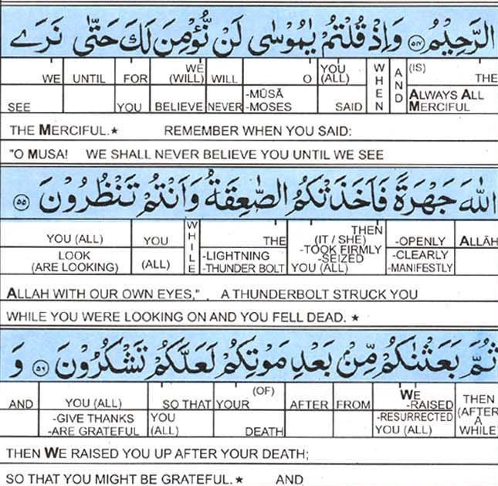
When Prophet Musa came with Tawrah, Bani Israel said that they would only believe him if they saw Allah (swt) with their own eyes. Seventy men from amongst them went to Koh e Tur and as a punishment lightning struck them and they died. Musa supplicated to Allah (swt) to give them life again and they were given life.
Verse 55-56

Slide 16
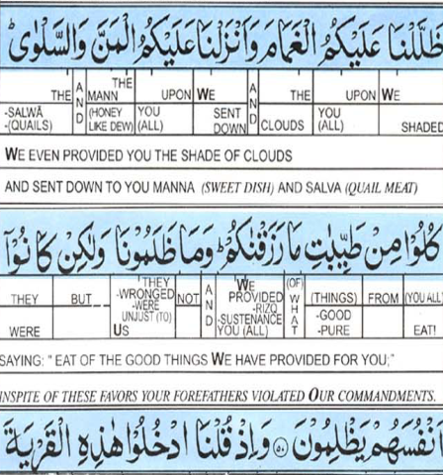
The shade of clouds was another blessing on Bani Israel. They were made to wander in a plain for 40 years. It is said that this area is between Egypt and Syria and it is only 10 miles long. Bani Israel used to travel in the day in search of their homeland and would find themselves at the place they had started from.
They were also provided with Manna and Salwa. Bani Israel were told to eat from the good things and not to store the food. But they disobeyed.
What is tayyab? Tayyab means clean, pure and halaal.
Verse 57

Slide 17
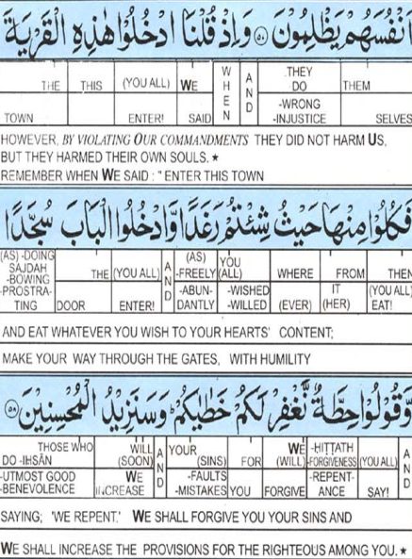
Bani Israel rebelled, disbelieved and committed injustice against themselves, even though
they saw the clear signs, tremendous miracles and
extraordinary events.
Bani Israel were commanded to submit to Allah in tongue and
deed and, to admit to their sins and seek forgiveness for
them, to be grateful to Allah for the blessings He gave them.
Verse 58

Slide 18
The summary of what the scholars have said about this
subject is that the Children of Israel distorted Allah's
command to them to submit to Him in tongue and deed.
They were commanded to enter the city while bowing
down, but they entered while sliding on their rear ends
and raising their heads! They were commanded to say,
`Hittah' meaning, "Relieve us from our errors and sins.''
However, they mocked this command and said, "Hintah
(grain seed) in Sha`irah (barley).'' This demonstrates
the worst type of rebellion and disobedience, and it is
why Allah released His anger and punishment upon
them, all because of their sinning and defying His
Commands.
Verse 58

Slide 19
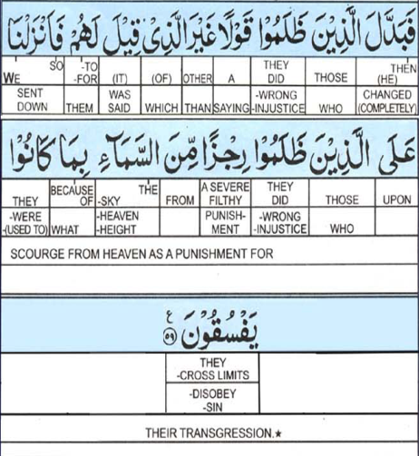

What is rijz?
It has many meanings. It can mean to cause worry, doubts created by Shaytan, plague.
Allah (swt) punished them by sending punishment from the sky. It is said that it was a form of plague.
The Messenger of Allah said,
The plague is a Rijz, a punishment with which Allah (swt) punished those before you.
Verse 59

Slide 20
رَبَّنَا تَقَبَّلْ مِنَّا إِنَّكَ أَنْتَ السَّمِيعُ العَلِيمُ [البقرة :127]
May Allah forgive me if I have made any mistakes or have given any false information.
Notes by Ummmomina

