Slide 1

Juzz 19
025-Surah Al Furqaan
Verses 29-34
Class notes

Slide 2
Our Objective
To be able to understand what Qur’an is saying in Arabic.
How to use these notes.
Memorize word for word meanings of each word.
Try to understand what the verse is saying.
Read notes.
Recite the verses in Arabic on the last slide. Inshaa Allah you will see the difference.
Verses 29-34

Slide 3
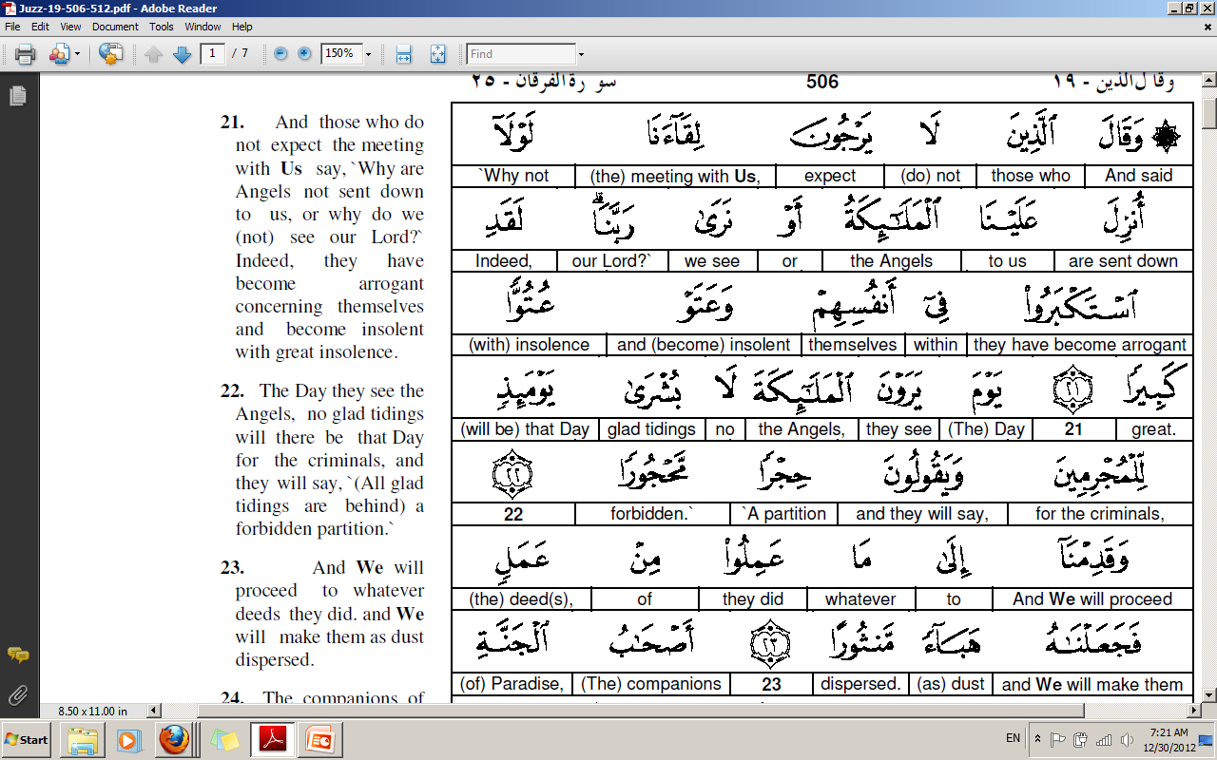

Slide 4
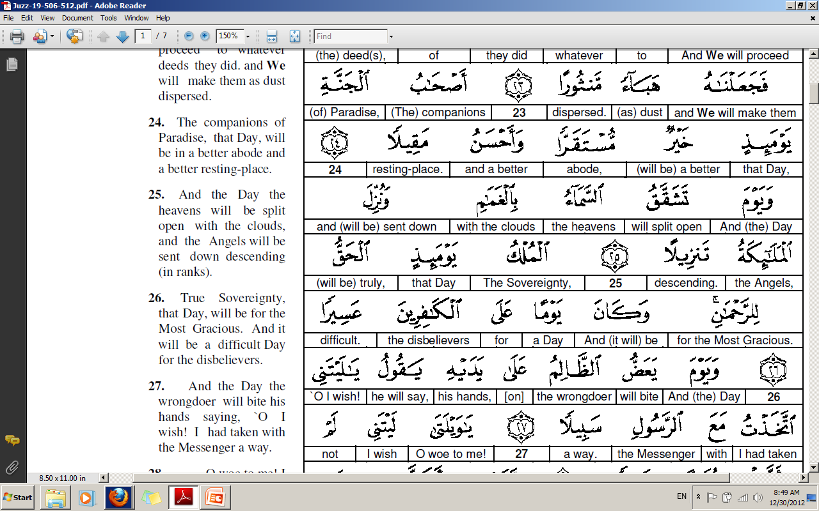

Slide 5
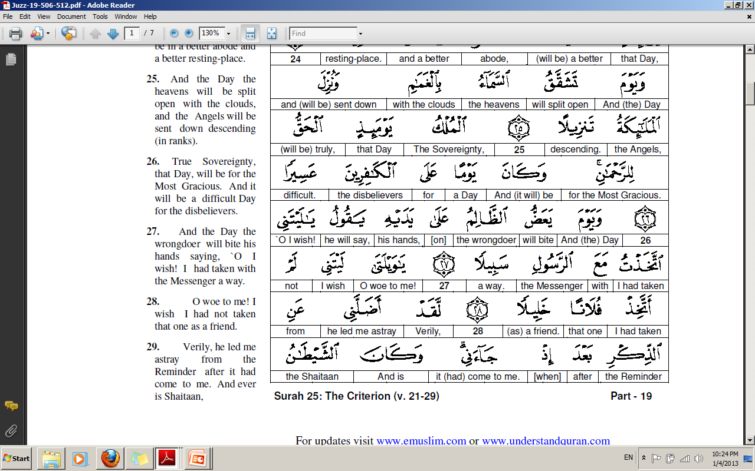

Slide 6
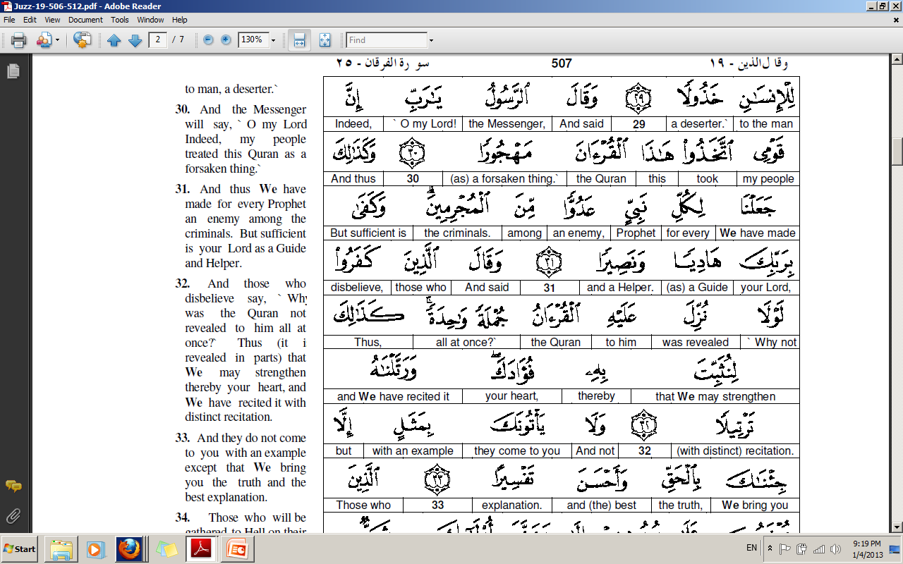

Slide 7
There are three types of 'friends‘…
Those that are necessary like nourishment and you cannot live without them;
those that are like medicine and are beneficial, so you need them sometimes;
and finally, those that are like a sickness and you do not need them at all!
How can one distinguish between his friends?
There are some friends who boost your faith (imaan).
Then there are some friends whom we do not meet frequently but when we need them we seek their advice and they are always there.
The third category is of those whom when one meet they back bite and gossip. They give you negative thoughts and make you depress.
One should be very careful about one’s friend as one is on the Deen of his friend and also a person is known from the company he keeps.
Verses 29

Slide 8
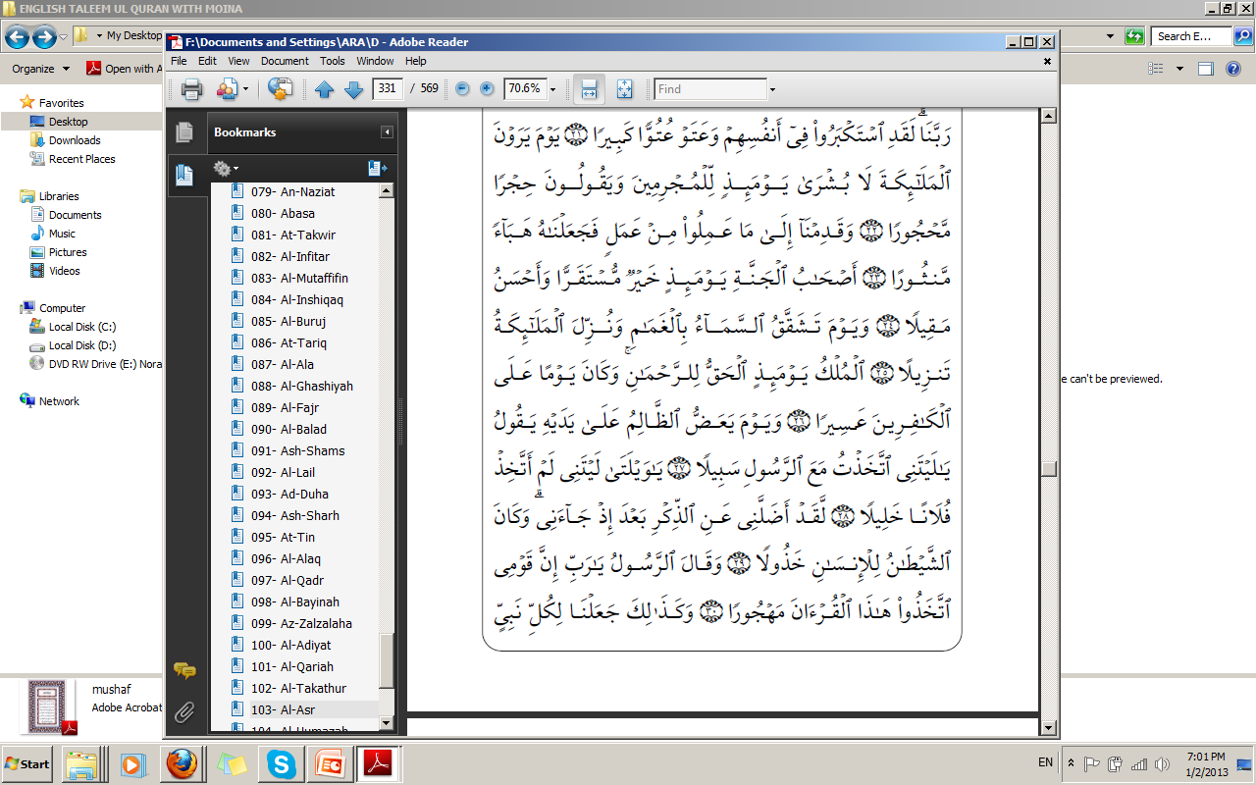
Friends can be compared to trees. Some give shade, some give fruit (are beneficial), some benefit in this world, and some benefit in both worlds and then there are some who neither give shade nor fruit they are like thorny bushes.
Always remember that a friend who has the quality mentioned in
Al Furqaan, is not actually your friend.
verse 29
Such a friend is extremely dangerous.
Any friend who takes you away from Qur’an is not good. One example is when one is learning Qur’an and a friend sends us a message on phone and distracts us. Shaytan also distracts us while we are praying.
One needs full concentration for work. Any kind of distraction spoils the work.
Verses 29

Slide 9
The word dhikr has many meanings.
It means
Advice,
Remembrance,
Salaah (prayer),
Qur’aan.
If we do not work honestly we fail to get full benefit from our work.
People around us, such as friends, colleagues, companions become a fitnah (trail) for us. It is due to the love of some people we go astray. Sometime we are so impressed with other people that we start following them instead of Allah’s commands.
Verses 29

Slide 10
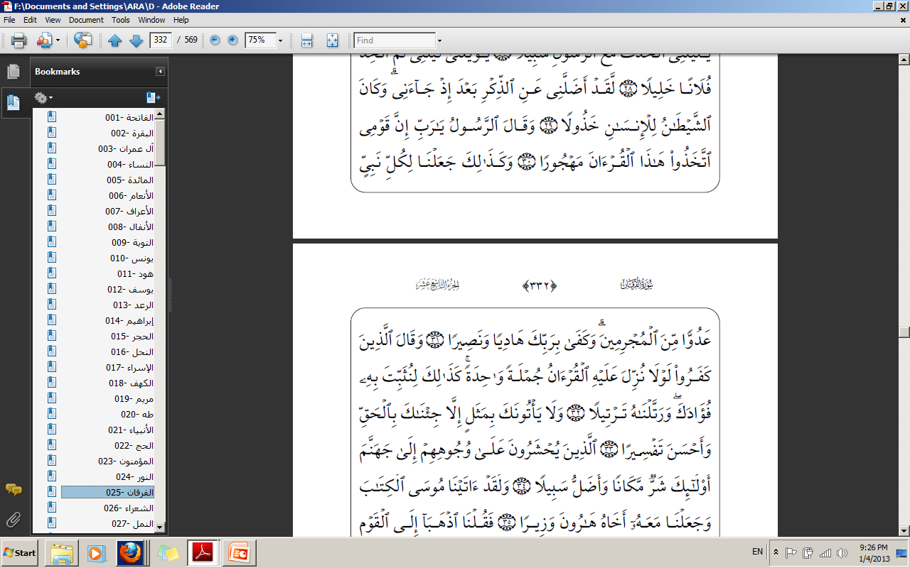
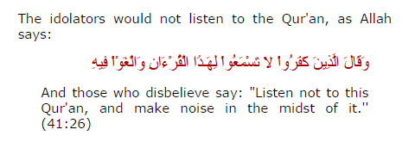
Allah tells how His Messenger and Prophet Muhammad will say: "O my Lord! Verily, my people deserted this Qur'an.''
My people here means “Quraish”.
One the day of Judgement Prophet Muhammad (pbuh) will give evidence in favor
of some and give evidence against some. The first people against whom he (pbuh)
will give evidence will be his own nation, the Quraish, as they were the first ones whom he (pbuh) invited to Islam.
Verse 30

Slide 11
Mahjuraa. (ha, jim, ra). If the root is hijr it means to desert and if it is hujr, it means to make fun of, or useless speech.
A general meaning of verse 30, is that the Prophet (pbuh) will give evidence against all those people who have deserted Qur’an.
Qur’an will also give evidence in favor or against people in the hereafter.
“Al Qur’an hujjatun laka aw alayka”. (Hadith)
In another hadith we learn that Sawm and Qur’an will intercede for those who fast and rectie Qur’an.
If you have read what is in verses 29 and 30 and then you ignore it and keep yourself busy in less important things, that is also “mahjura”.
Verse 30

Slide 12
How do people “desert” Qur’an?
There are different levels of “deserting” Qur’an.
There are the disbelievers who do not believe that Qur’an is a book from Allah.
Then there are some who believe but they ignore it. They say that it is too
sacred to be opened and learned.
When the Prophet (pbuh) would recite Qur'an to them, they would
talk nonsense or speak about something else, so that they would not hear it. This is a form of forsaking it and rejecting it, and not believing in it is the same as forsaking it, and not pondering its meanings and trying to understand it is the same as forsaking it, and not acting upon it and following its commandments and heeding its prohibitions is the same as forsaking it, and turning away from it in favor of poetry or other words or songs or idle talk or some other way is the same as forsaking it.
People fail to take it as Furqaan (distinguisher between right and wrong).
Verse 30

Slide 13
Why do people harm prophets of Allah?
Prophets are Allah’s favorite creations.
This is because Allah has given everyone free choice. When the prophets
convey Allah’s message to people they have the choice to accept it or not. The criminals have used this freedom from Allah to torture Allah’s prophets in every age.
Wa kafaa bi rabikaa….Allah is sufficient against the propaganda of the criminals.
This was revealed to strengthen the Prophet’s (pbuh) heart and to tell him that the enmity of the opposition will not harm him.
Jumla means “as a whole” , at one time.
Verses 31-32

Slide 14
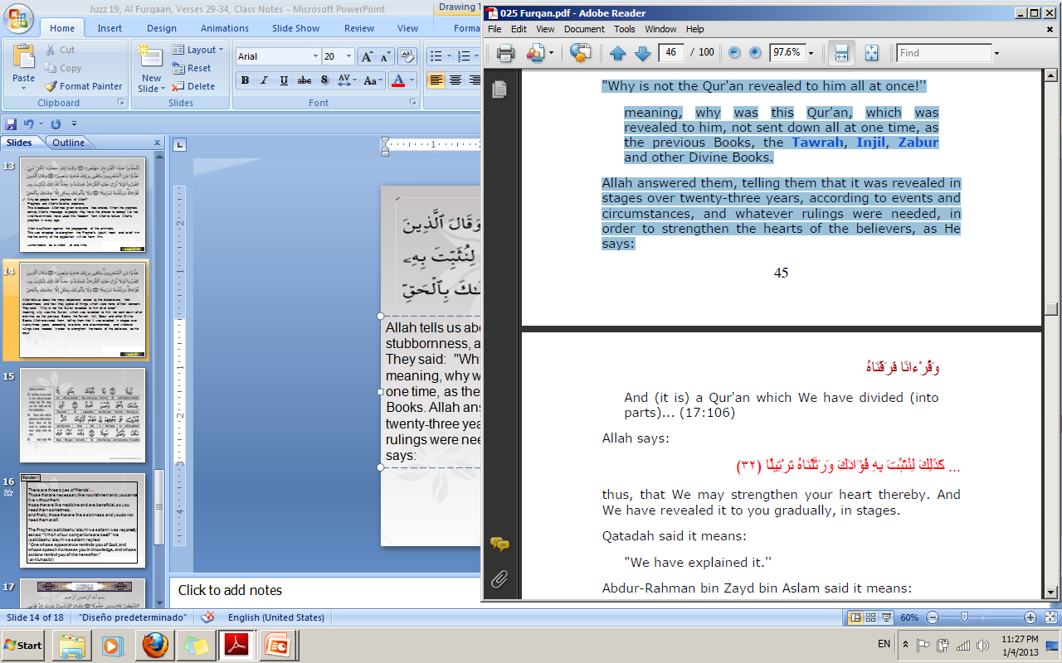
Allah tells us about the many objections raised by the disbelievers, their stubbornness, and how they spoke of things which were none of their concern. They said: "Why is not the Qur'an revealed to him all at once!''
meaning, why was this Qur'an, which was revealed to him, not sent down all at one time, as the previous Books, the Tawrah, Injil, Zabur and other Divine Books. Allah answered them, telling them that it was revealed in stages over twenty-three years, according to events and circumstances, and whatever rulings were needed, in order to strengthen the hearts of the believers, as He
says:
Verse 32

Slide 15
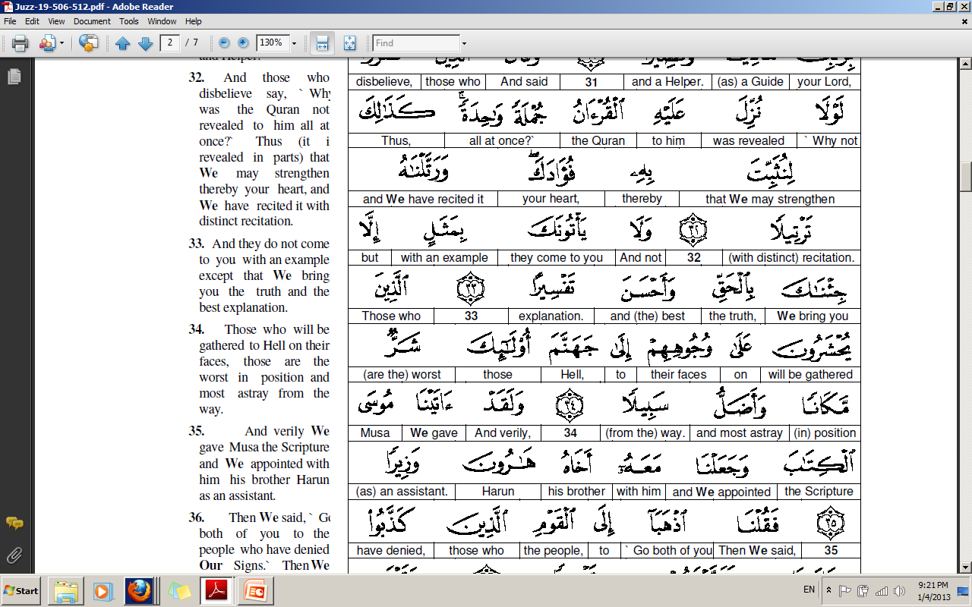

Slide 16
The disbelievers wanted to prove from this objection that Qur’an was not from Allah. It was written by Prophet Muhammad (pbuh) in bits and pieces.
Fuada. (fa hamza daal). It means to barbecue meat. This word has heat and intensity. So when a person’s emotions are mentioned this word is used for heart. The other word used for heart is “qalb”. Here “fuada” word is used to tell the Prophet (pbuh) that at times when his heart is sad, disturbed because of what people are saying Allah brings a verse to bring peace to his heart.
The word “rattala” (ra ta laam). It means to do something in an organized manner. For Qur’an it means to read Qur’an slowly.
To have order and beauty in speech (kalaam). (Imam Razi)
It also means to read with a good voice.
Verse 32

Slide 17
Tafseer. (fa seen ra). It means to explain something. To expose something that has
been covered. To remove the lid from something.
Verse 33. They do not say anything in an attempt to oppose the truth, but
We respond to them with the truth of that same matter, more clearly and more
eloquently than anything they say.
Who are the “aladheena” in verse 34? These are those who criticize and object Qur’an. Today it is a fashion to criticize and question Qur’an. Many say that Qur’an is backward.
In the Sahih, it is reported from Anas that a man said,
"O Messenger of Allah, how will the disbeliever be gathered on his face on the Day of Resurrection?'‘ The Prophet said:
The One Who caused him to walk on his two feet is able to make him walk on his face on the Day of Resurrection.
Why the face? It was the face they used to criticize in the world!
Verses 33 -34

Slide 18
Verse 34.
Adulla is ism tafdeel. Meaning extremely misguided. One who was misguided in the world and will be put in the worst place “shurrum mekaana” in the hereafter.
Sabeela means madhab, lifestyle that one follows.
Verses 33 -34

Slide 19
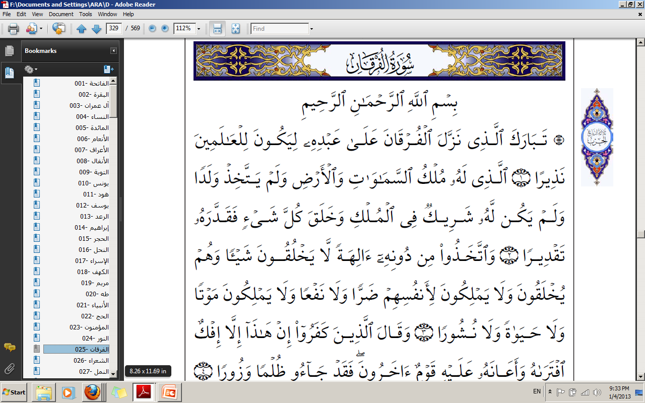

Slide 21
رَبَّنَا تَقَبَّلْ مِنَّا إِنَّكَ أَنْتَ السَّمِيعُ العَلِيمُ [البقرة :127]
May Allah forgive me if I have made any mistakes or have given any false information.
Notes by Umm Momina

