Slide 1
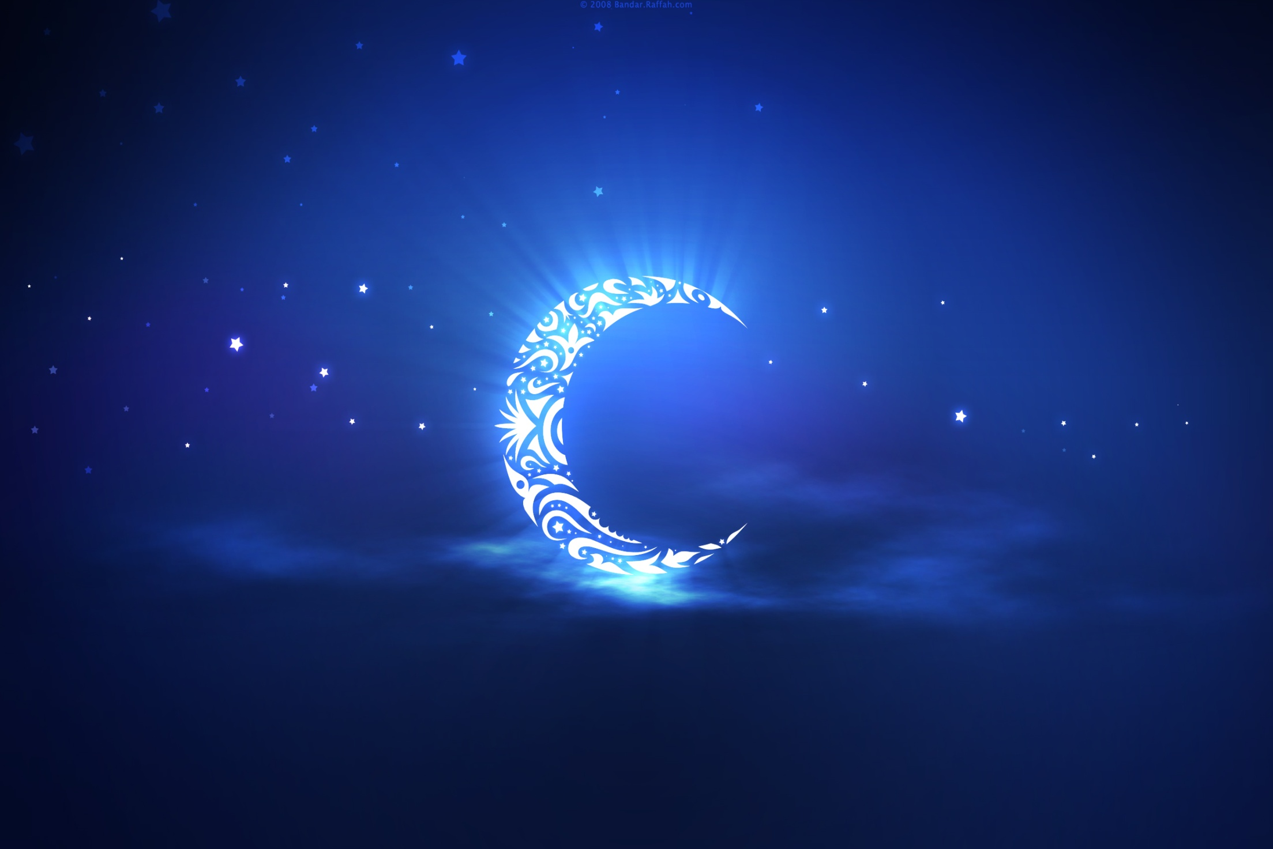
Ramadan Workshop
Saturday 15th June 2013

Slide 2
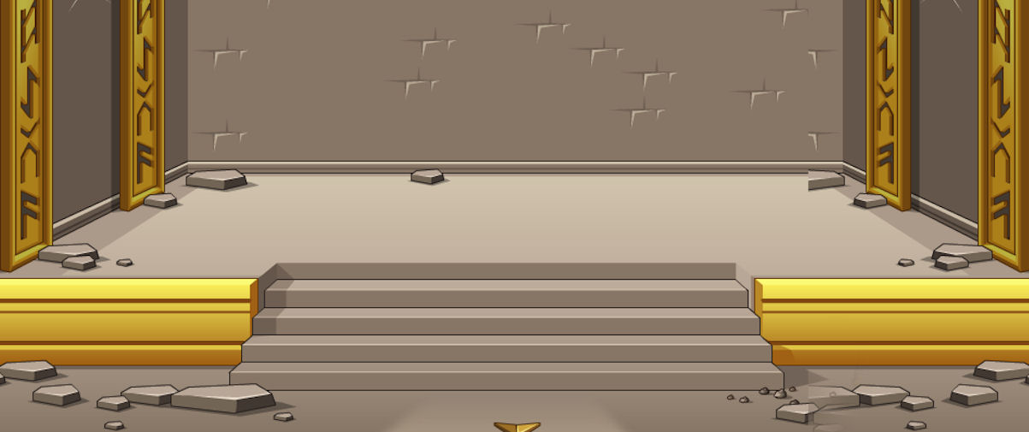


Zakah
Salaah
Sawm
Shahadah
Hajj

Slide 3

What is Fasting?
Fasting is also called Sawm
Fasting is performed in Ramadan

Slide 4

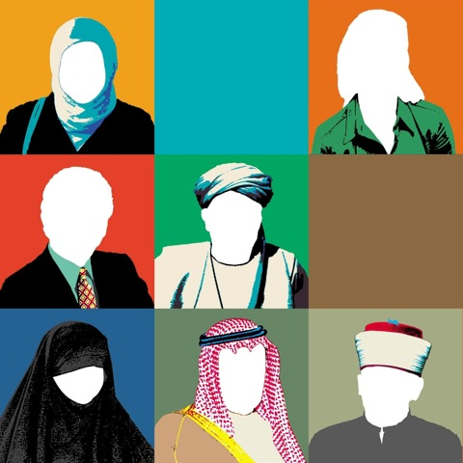
Who can fast?
A sane muslim man or women

Slide 5

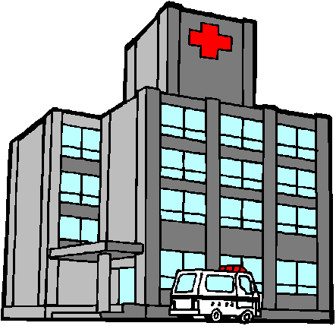
Fasting Is Fard!
‘Fard’ means compulsory.
Allah (SWT) has made fasting a Fard on us.
The only people that fasting in not Fard on are the mentally ill and very young.

Slide 6

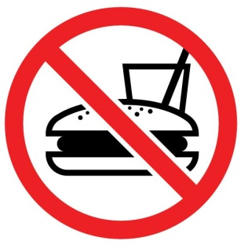

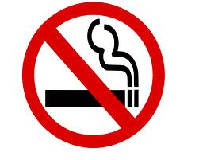
What breaks your fast?
Intentional eating and drinking
Intentional vomiting
To swallow lots of blood coming from the gums
To break your fast before (Magrib) the sun sets
Smoking

Slide 7

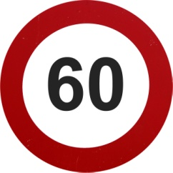
Kaffarah
When you break your fast by drinking, eating or smoking intentionally you have to make up for those fasts this is called ‘Kaffarah’.
You perform Kaffarah by fasting for
Consecutive days

Slide 8


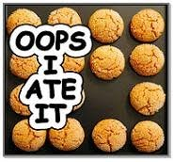
What doesn’t break your fast?
A insect flying down the throat by accident
To eat or drink by accident
Water entering the ears
Dust going down the throat
Swallowing your saliva

Slide 9

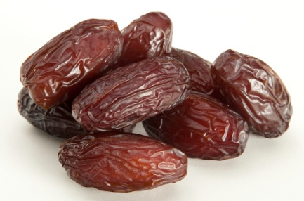
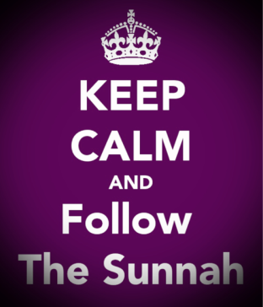
Iftar!
We should break our fast with fresh dates.
This is Sunnah.
Sunnah is the following of the Prophet Muhammad (P.B.U.H) and what he did.

Slide 10

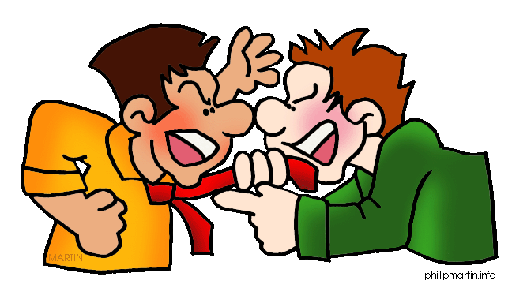
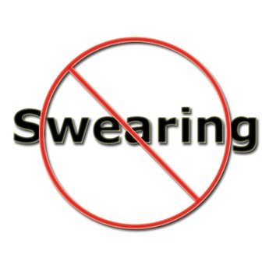
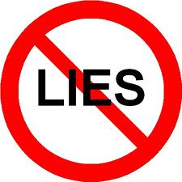
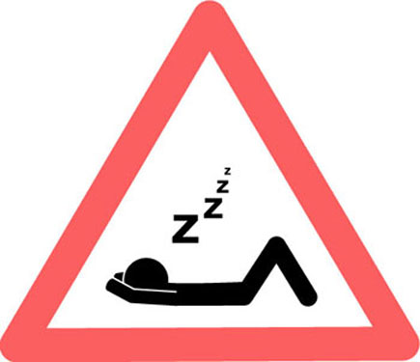

What we should avoid during Ramadan and fasting
Arguing with anyone
Fighting and swearing
Lying to anyone
Wasting time e.g. sleeping throughout your fast
Gossiping

Slide 11


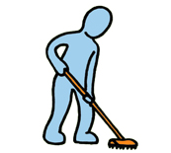

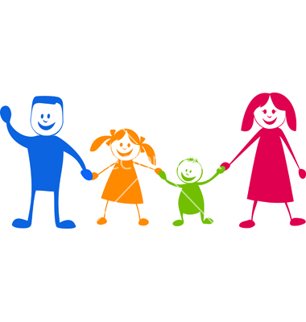
What good things we can do during ramadan/fast
Listening to our parents
To be patient with your brothers/sisters everyone
To be kind and forgiving
Help with the house work
To think about Allah and all the blessings he has given us.

Slide 12

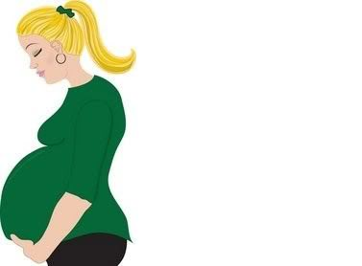
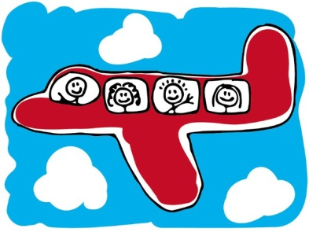

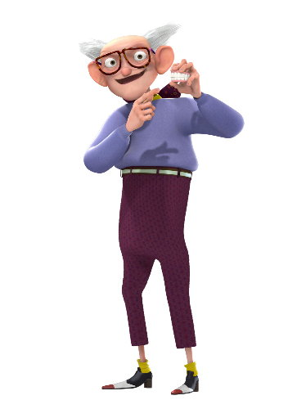
Who can miss the fast?
A person who is travelling e.g on a train, plane, car journey.
Pregnant women
A sick person who has to take specific medicine
The elderly who are unable to fast

Slide 13

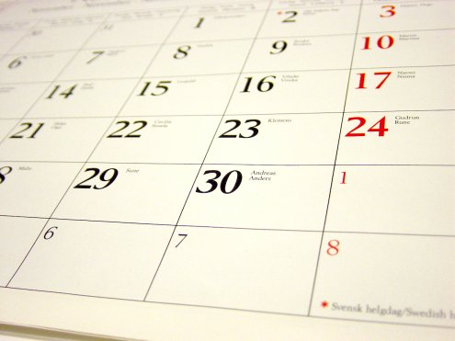
Makeup Fast
When you do not fast for a valid reason you have to make up that fast.
All you have to do is fast on another day of the year, this is a ‘makeup fast’
Notes:
Valid reason- travelling, sick.

Slide 14

Extra Fasts
The prophet used to fast on the 9th and 10th of Muharram and the 9th Dhil Hijjah.
Forbidden (Haraam) days to fast
Eid- ul- Adha – eid after ramadan
Eid- ul- Fitr- eid where we sacrifice a sheep
3 days after Eid ul Adha
Notes:
Musa and his people were saved from the pharo on 10th Muharram, we also fast on the 9th because the jews fast only on the 10th as well, so to be different we fast on the 9th. 9th Dhil Hijjah is the day of Araffat, and that is a day for people who are performing Hajj to make lots of Dua.

Slide 15

Night of Power
The last ten days are very important as during these ten nights we should seek for Allah’s forgiveness
In one of the odd nights (Layla- tul- Qadar) ‘21, 23, 25, 27, 29’ the quran was revealed to the prophet in cave Hirra.
The number 10 in arabic is Ashrah
Many people on the last ten days sit in I’tikaf.
Notes:
Whoever establishes the prayers on the night of Qadr out of sincere faith and hoping to attain Allah's rewards (not to show off) then all his past sins will be forgiven. Bukhari
Night comes before day (REMIDER)

Slide 16

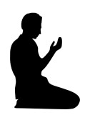
I’tikaf
I’tikaf is when you completely devote yourself to Allah. You don’t involve yourself in worldly activities like watching tv, going on the computer. You pray and ask for forgiveness and always think about Allah. Many people perform I’tikaf in the mosque, they sleep there and come out only if necessary.
Only Sane and clean Muslims can perform I’tikaf.

Slide 17

Key Words
I’tikaf- devoting yourself to Worshipping Allah (SWT) alone.
Sunnah- following the ways of the Prophet Muhammad (P.B.U.H)
Kaffarah- Fasting for 60 consecutive days because the fast was broken intentionally
Haraam- Forbidden to do by Muslims
Fard- Means ‘compulsory’
Ashrah- 10 in Arabic

