Slide 1
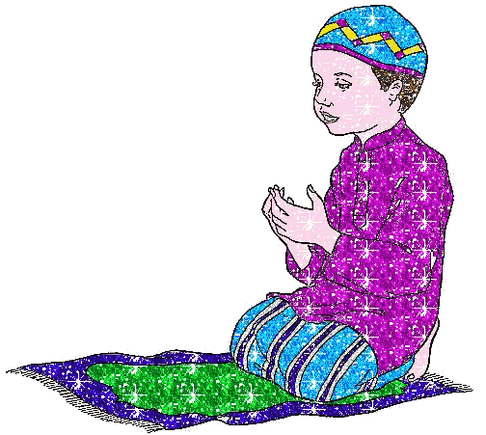
Things Which Invalidate The Prayer (Mubdilatu-Salaat)

Slide 2
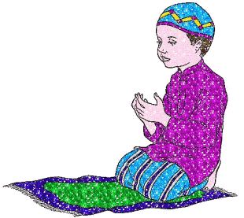
Prayer if performed well with due regard to its conditions, pillars, duties and preferred acts, truly illuminates the heart and purifies the soul.
It is the means by which man communicates with Allah (subhanahu wa ta'ala) and therefore, one should keep it free from anything which would render it invalid.

Slide 3
Check your knowledge!
Which of the following statements invalidate (break) the prayer
Speaking or talking in the course of the prayer.
Laughing in the course of the prayer.
Eating while praying, even though what is eaten maybe as small as a piece of dates..
Starting the prayer by saying Allahu Akbar.
If someone in the course of the prayer remembers that he/she did not actually perform the ablution (wudhu), and continues to pray.
Standing in prayer.

Slide 4
Check your knowledge!
If a person's ablution (wudhu) gets invalidated in the course of the prayer, then the prayer becomes invalid.
The prayer is also invalidated by carrying out the Rukuu and Sujuud postures with haste and without ease.
While in prostration, bobbing (jerking) up and down like chicken pecking food from the ground is allowed.
Turning oneself away from the direction of the Qiblah also invalidates the prayer

