Slide 1
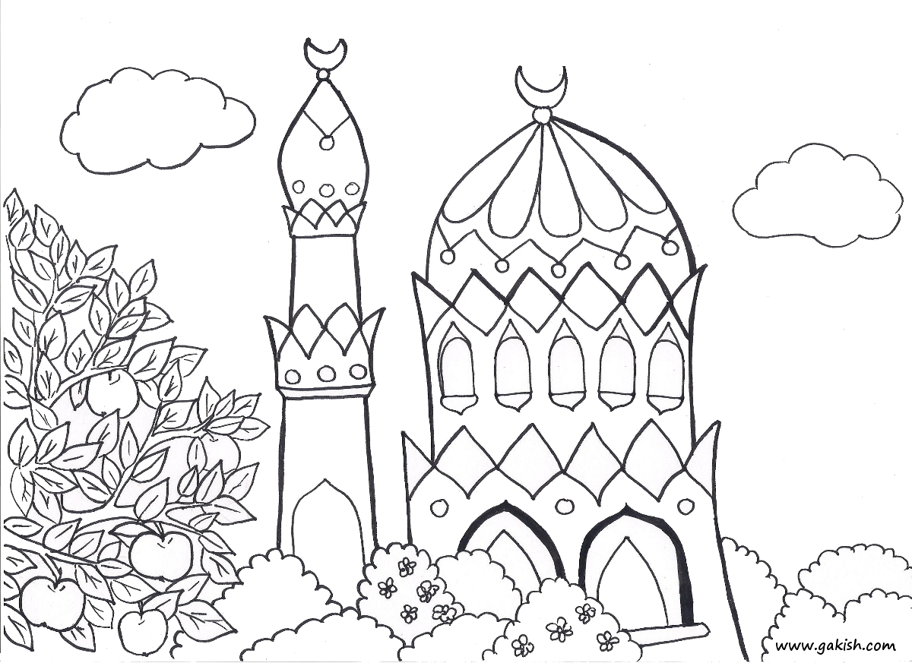
Salluu kama raeytumunii usali” (Al-Bukhari)
"Perform your prayers in the same manner you have seen me doing."
Salat
un Nabi
Course 2013
--
For ages 10-15
Day 1

