Slide 1


Stories of the Prophets-
Prophet Saleh a.s.

Slide 2

Once upon a time ,there lived a tribe called Thamud. The people of Thamud were very rich. Allah swt had blessed them with wealth, fruitful gardens and farms. They were very strong .
They built for themselves huge home
in mountains so that no
storm or earthquake
could destroy them.
But they were
idol-worshippers.

Slide 3
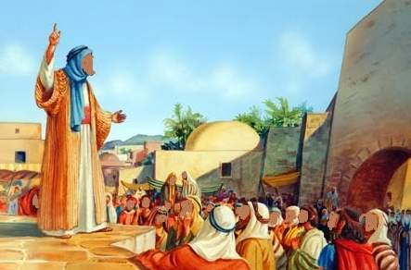
There lived a very pious man Saleh in Thamud. He was very well-known for his knowledge and wisdom. Allah swt chose Saleh a.s. to be His prophet for the people of Thamud. He advised people to leave idol-worship and turn to only on Allah and worship Him alone.

Slide 4
Prophet Saleh a.s. warned his people not to worship idols since idols are man-made and powerless and cannot help anyone. This made people of Thamud angry.
The elders of Thamud asked Prophet Saleh to show them a miracle and only then they will believe in Allah swt. And leave their idols.

Slide 5
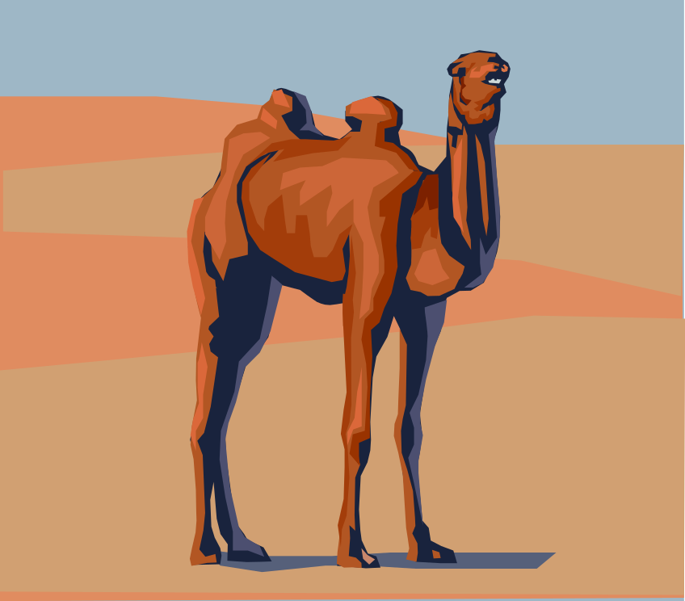
They further asked him that they will not accept any miracle but they wanted a special she-camel to appear from the mountains. They said : only then we will believe you.

Slide 6
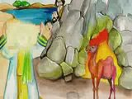
Prophet Saleh a.s. raised his hands and prayed to Allah swt for the miracle to happen.
No sooner had he
started praying,
the mountain split
and there appeared
a huge she-camel .

Slide 7
Prophet Saleh now warned his people that this camel was a sign from Allah so they should all now turn to Allah swt and if they harmed the camel, Allah swt will punish them severely.
He further said that the camel will drink the water from the spring one day and the people can drink it the next day so they should take turns. In return , they will benefit from the milk of the camel.

Slide 8
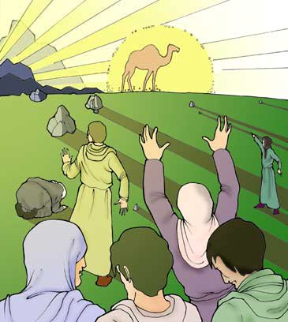
Meanwhile, many people
after seeing the camel,
left idol-worshipping
and startedd following
Prophet Saleh a.s. and
his teachings.
This angered their elders
and they planned to do
something about it .
They decided to kill
the camel.

Slide 9
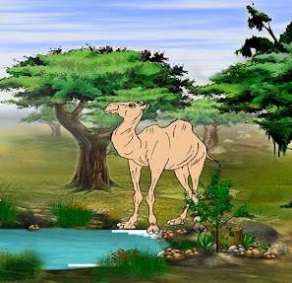
One day when the camel came to drink water from the spring, a group of evil people killed it.
When Prophet Saleh as
came to know about this
incident, he became very
sad because the people
had ignored the warning
of Allah about the camel.
He addressed them and
said , You have only three
days to ask forgiveness
from Allah for this act,
otherwise all of you will be destroyed.

Slide 10
The people of Thamud were very stubborn and they refused to make tauba and did not ask Allah swt for forgiveness.
As for the people who believed him, Allah swt ordered them to leave that place because Allah swt never punishes those who are pious and believe in One Allah alone.

Slide 11
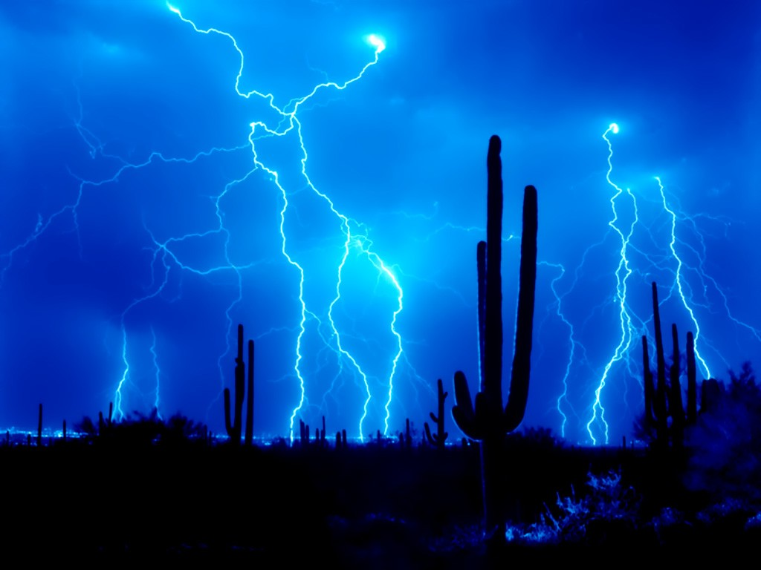
Three days after Prophet Saleh's warning, thunder storms filled the air, followed by severe earthquakes which destroyed the entire tribe.
The land was violently shaken,
destroying all living creatures
in it. There was one terrific cry
with which all of the
disbelievers were
dead, at the same time.
Their strong buildings or homes could not protect them.

Slide 12
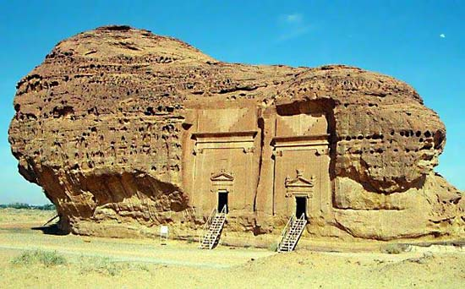
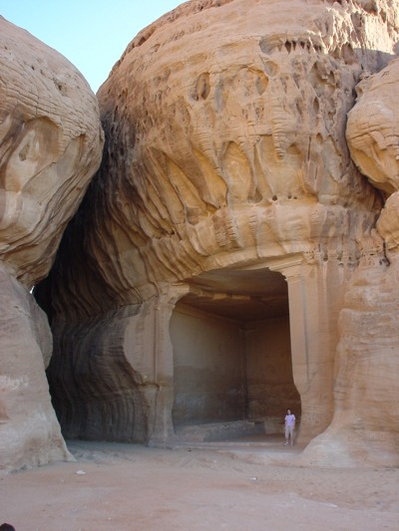
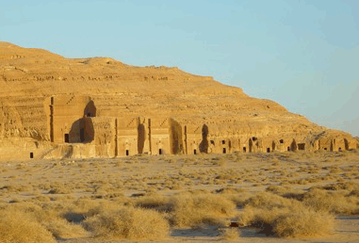

Slide 13
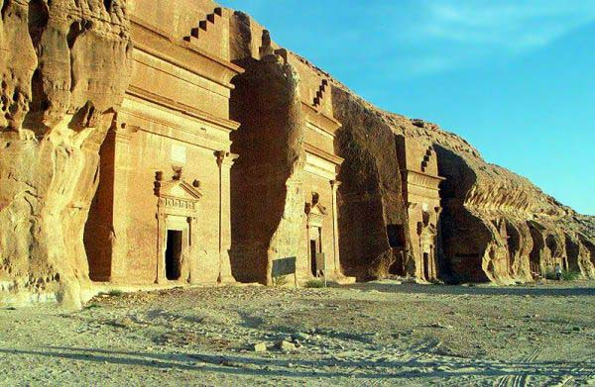
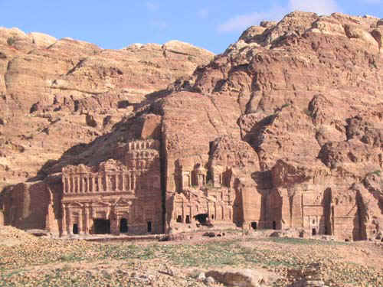

Slide 14
Happy Land For Islamic Teachings

