Slide 1

Who narrated this hadith?
Happy Land for Islamic Teachings-Hadith 02

Slide 2
Type true or false:
The man who visited the Prophet peace be upon him was wearing a white thobe.
This hadith was narrated by Abu Al Khattab.
The companions did not know the man.
The man asked the Prophet peace be upon him about Islam.
The man came to the Prophet peace be upon him when the Prophet peace be upon him was alone
Happy Land for Islamic Teachings-Hadith 02

Slide 3
------
----
Pillars of Islam
----
------
----
What is Islam?

Slide 4
What is Iman?

Slide 5

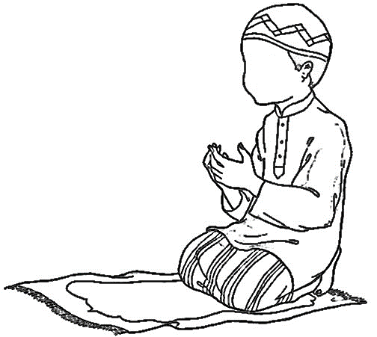
What is Ahsan?
Close your eyes, remind yourself that He is watching. Your deeds, your patience will never go wasted. Remind yourself it is all being written down for later.
Open your eyes and keep going
The Prophet peace
be upon him said
Ahsan is -------------------
------------------------------
------------------------------
------------------------------
------------------------------
------------------------------
------------------------------
Allah swt
is watching me

