Slide 1

Imam Muhyi al-Din
Abu Zakariya Yahya
bin Sharaf al-Nawawi

Slide 2
- for short Imam Nawawi, was born in the village of Nawa in the vicinity of Damascus in 631 A.H. (1233 A.D.).
Imam Muhyi al-Din Abu Zakariya Yahya
bin Sharaf al-Nawawi

Slide 3
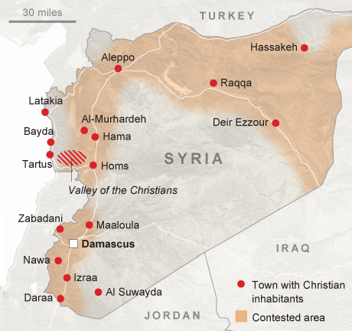
He grew up in Nawa and at the age of nineteen
went to study
in Damascus
which was considered the center of learning and scholarship.

Slide 4
Birthplace
of Imam An Nawawi

Slide 5
Quiz
Answer
Answer
Answer
Answer
Imam Nawawi was born in …
Imam Nawawi was born at…
His father’s name was..
His son’s name was…

Slide 6
Imam Nawawi’s Education
During his stay at Damascus, Imam Nawawi studied from more than twenty celebrated teachers, regarded as masters and authorities of their fields and disciplines.

Slide 7
He studied Hadith, Islamic jurisprudence and principles,
syntax (organization of words in sentences ) and Etymology (history of words) from great scholars.
Imam Nawawi had endless thirst for knowledge. He used to read twelve lessons daily and wrote commentaries on every lesson.
Whatever books he read, he would write marginal notes and explanations on each book.

Slide 8
He studied , Islamic jurisprudence and principles,
syntax (organization of words in sentences ) and Etymology (history of words) from
Imam Nawawi had endless thirst for . He used to read twelve lessons daily and wrote commentaries on every lesson.
Whatever books he read, he would write marginal notes and on each book.

Slide 9
His intelligence, hard work, love, devotion and absorption in his studies amazed his teachers and they became fond of him and began to praise and admire him.
Allah had also conferred upon him the gift of fast memorization and depth of thought.
Imam Nawawi made full benefit of his God given qualities and potentialities and earned the highest degree of honor.

Slide 10
His teachers were amazed because he was…
-----
------
------
------

Slide 11
Imam Nawawi led a life of singular piety (strong belief), righteousness and simplicity.
After over 20 years, he returned to his hometown. Soon after his arrival at Nawa, he fell ill and died in 676 A.H. (1278 AD).

Slide 12
ACTIVITY

Slide 13
D A P H A 6 7 6 A H B P A Z G K
W Y E G T A S N O S S E L 2 1 K
X I M I W A B W E R V K F M Z B
F A S T M E M O R I Z A T I O N
N E N S U C S A M A D Q Q Z O K
M J T T Z T V P A X B L R C O K
T B Y R J H E P I A V Y S E J P
T P I O L D H Y W S T W I O O L
F C N N A W A R A Y R M S A V M
G Z F C G D P N W X K Y G O B T
Q B Q S V C M J A Y R E N W F B
Z S F D A L I F N G 1 N L B N A
M Z E G Z N K N M 9 K J N M L Q
C N C U V X I J A O Z B G T X C
O Z H G I C J B M K A F C N C O
E O V A O B U W I Q P I Z L W L
Find the following in the given puzzle
676AH
age19
Damascus
fastmemorization
Imam Nawawi
Nawa

