Slide 1
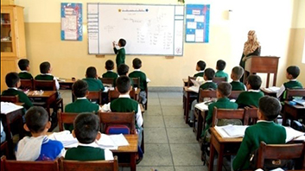
Optimizing
The Learning Outcomes in the Qur’an Class

Slide 2

Class management

Slide 3
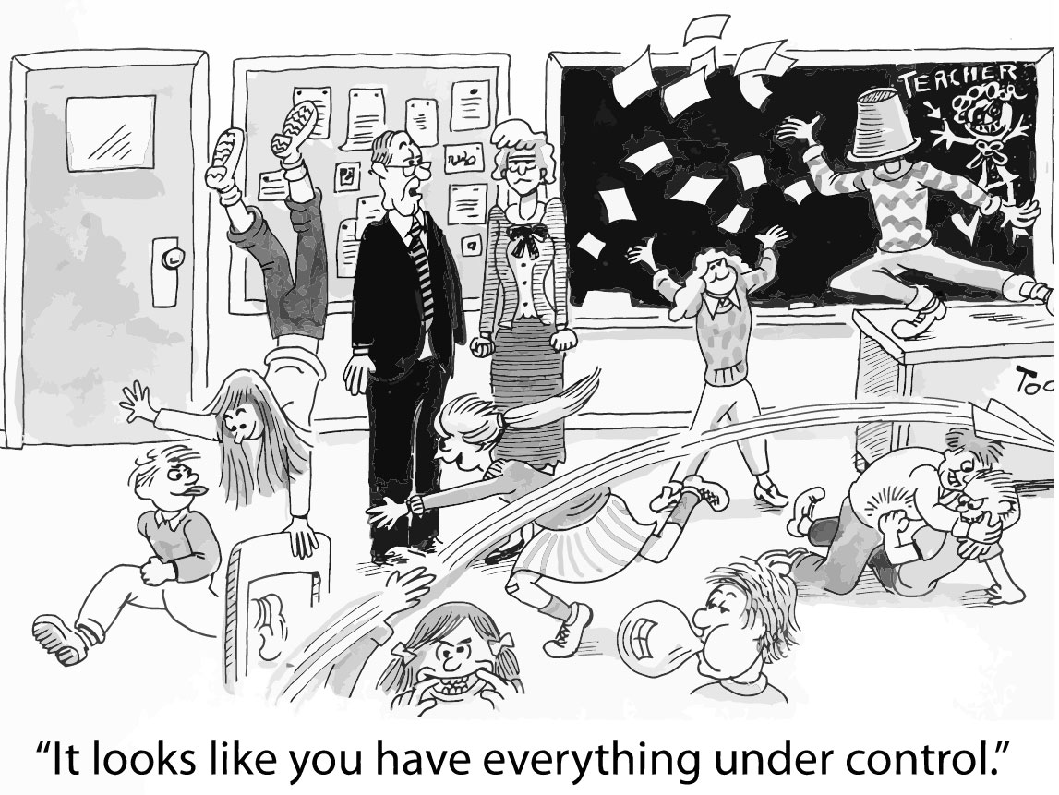
effective instruction requires effective classroom management, and that strong management skills are the foundation of strong teaching.

Slide 4
What is class management?
Class Management is the methods and strategies an educator uses to maintain a classroom environment that promotes student success and learning.

Slide 5
Class managing skills are skills educators need, to keep students:
    Organized
    Focused
    Attentive
    Academically Productive

Slide 6
A well managed class is a product of:
An experienced caring and consistent teacher who creates a supportive learning environment and engages students in a well-crafted well-planned dynamic curriculum with differentiated instruction.
2. A safe and supportive learning environment (an inviting traffic oriented
class layout, clear class rules, consistent class routine, a cooperative
interactive community with established channels of communication).
3. Engaged students who: belong and feel safe and appreciated, bond with
the teacher and with each other, take part in setting class rules, practice
class routine, clearly understand the class expectations and are motivated
to meet class expectation.

Slide 7
Environment
Students
Teacher
Classroom Management

Slide 8
The Class environment

Slide 9
Ice breakers
& class builders
Activities used in the first days of class to:
Overcome the discomfort and feeling of disconnect students may have
Encourage teamwork
Build teacher-student rapport

Slide 10
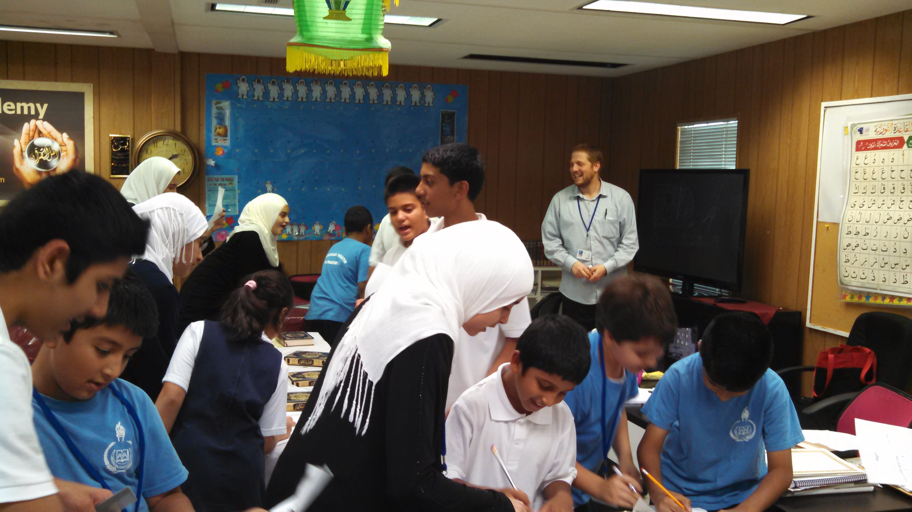
Class Building Activity On Day 1: Get a signature of …

Slide 11
Identity circles

Slide 12
4 Corners
Strongly Agree
Somewhat Agree
Somewhat Disagree
Strongly Disagree

Slide 13
Your greatest ally
Parents need to know that you care
Catch your student doing something great (call the parents or send home a note or a short video)
Aim for 1 positive note in the first week, 3 positive notes every quarter

Slide 14
Class rules
About 5
Students should be involved
in setting the rules and deciding on the consequences

Slide 15

Traffic Light
Do not talk. (Instruction time)

Slide 16

Questions/Answers Time
Talk after getting permission.

Slide 17

Group Activity time
Talk without permission

Slide 18
Nonverbal Intervention
Silently manage student behavior without disrupting a lesson.
Establish eye contact or make agreed upon gestures that let students know they are off-task
or simply move closer to a disruptive child and continue teaching.

Slide 19
Establish and practice class procedures

Slide 20
Establish Class Routine:
Entry Routine: a consistent, daily routine that begins as soon as students enter the classroom
Bell Work: a brief written activity
intended to get students settled,
focused, and prepared for instruction

Slide 21
Transition Routines: steps and settings that students learn and do quickly & repeatedly without much teacher directions. The teacher only needs to say, “Reading time!” or “Center Time!” and students know what to do.
End of Class Routine: Exit Tickets – Silent 30

Slide 22
Manage students who move between classes
Have seating plan prepared before they enter
Have an activity ready for them on their descks
Write clear instructions on the board
Write the class objectives on the board

Slide 23
… Manage students who move between classes
Meet the students right outside class
Give clear instructions to line up to enter
Recognize students who follow instructions & move them to the front of the line to enter first
Give a warm welcome at the door

Slide 24
Use clear instructions
“Line up quietly.” ??????????????
“Stand up without talking, facing the door, with your hands to your sides.”√ √ √

Slide 25
Applaud: Publicly recognize and group-praise students who have done something good. This establishes a group culture in which learning accomplishments and positive actions are socially valued and rewarded.
Class join me, let’s cheer for Ahmad”
«ما شآء الله أحمد !»
«هذا من فضل ربِّى.»

Slide 26
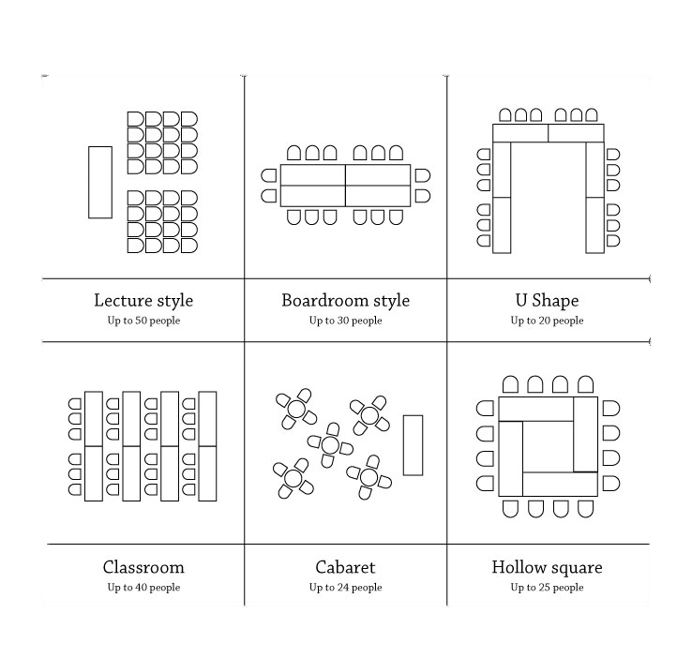
Seating
Arrangements

Slide 27
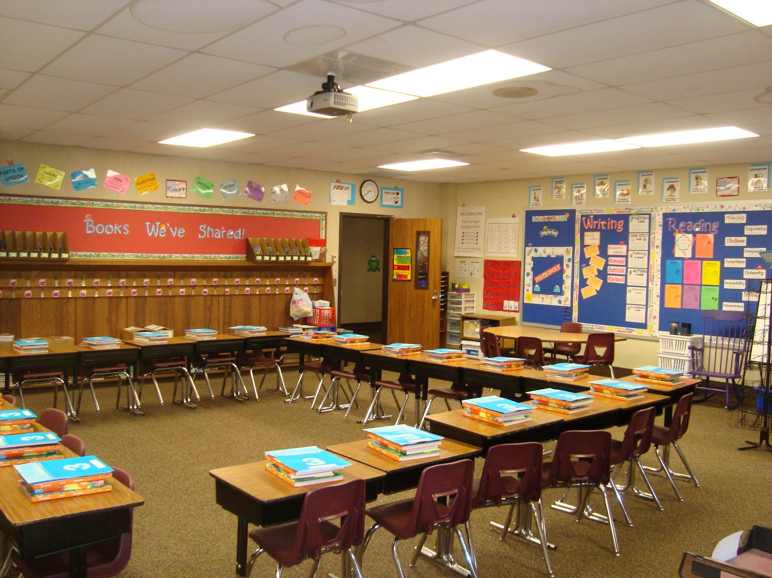

Slide 28
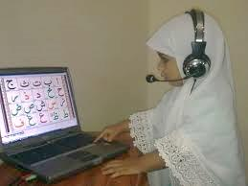
-Design an inviting traffic
oriented class layout
-Decorate with useful visuals
-Ensure accessible class material
and technology

Slide 29
students

Slide 30
Build Community
Know Your Students
Clarify Expectation
Differentiate & Keep them Engaged

Slide 31
Know Your students
Names
Learning styles:
  Pre-Assessment
  Screening Activities

Slide 32
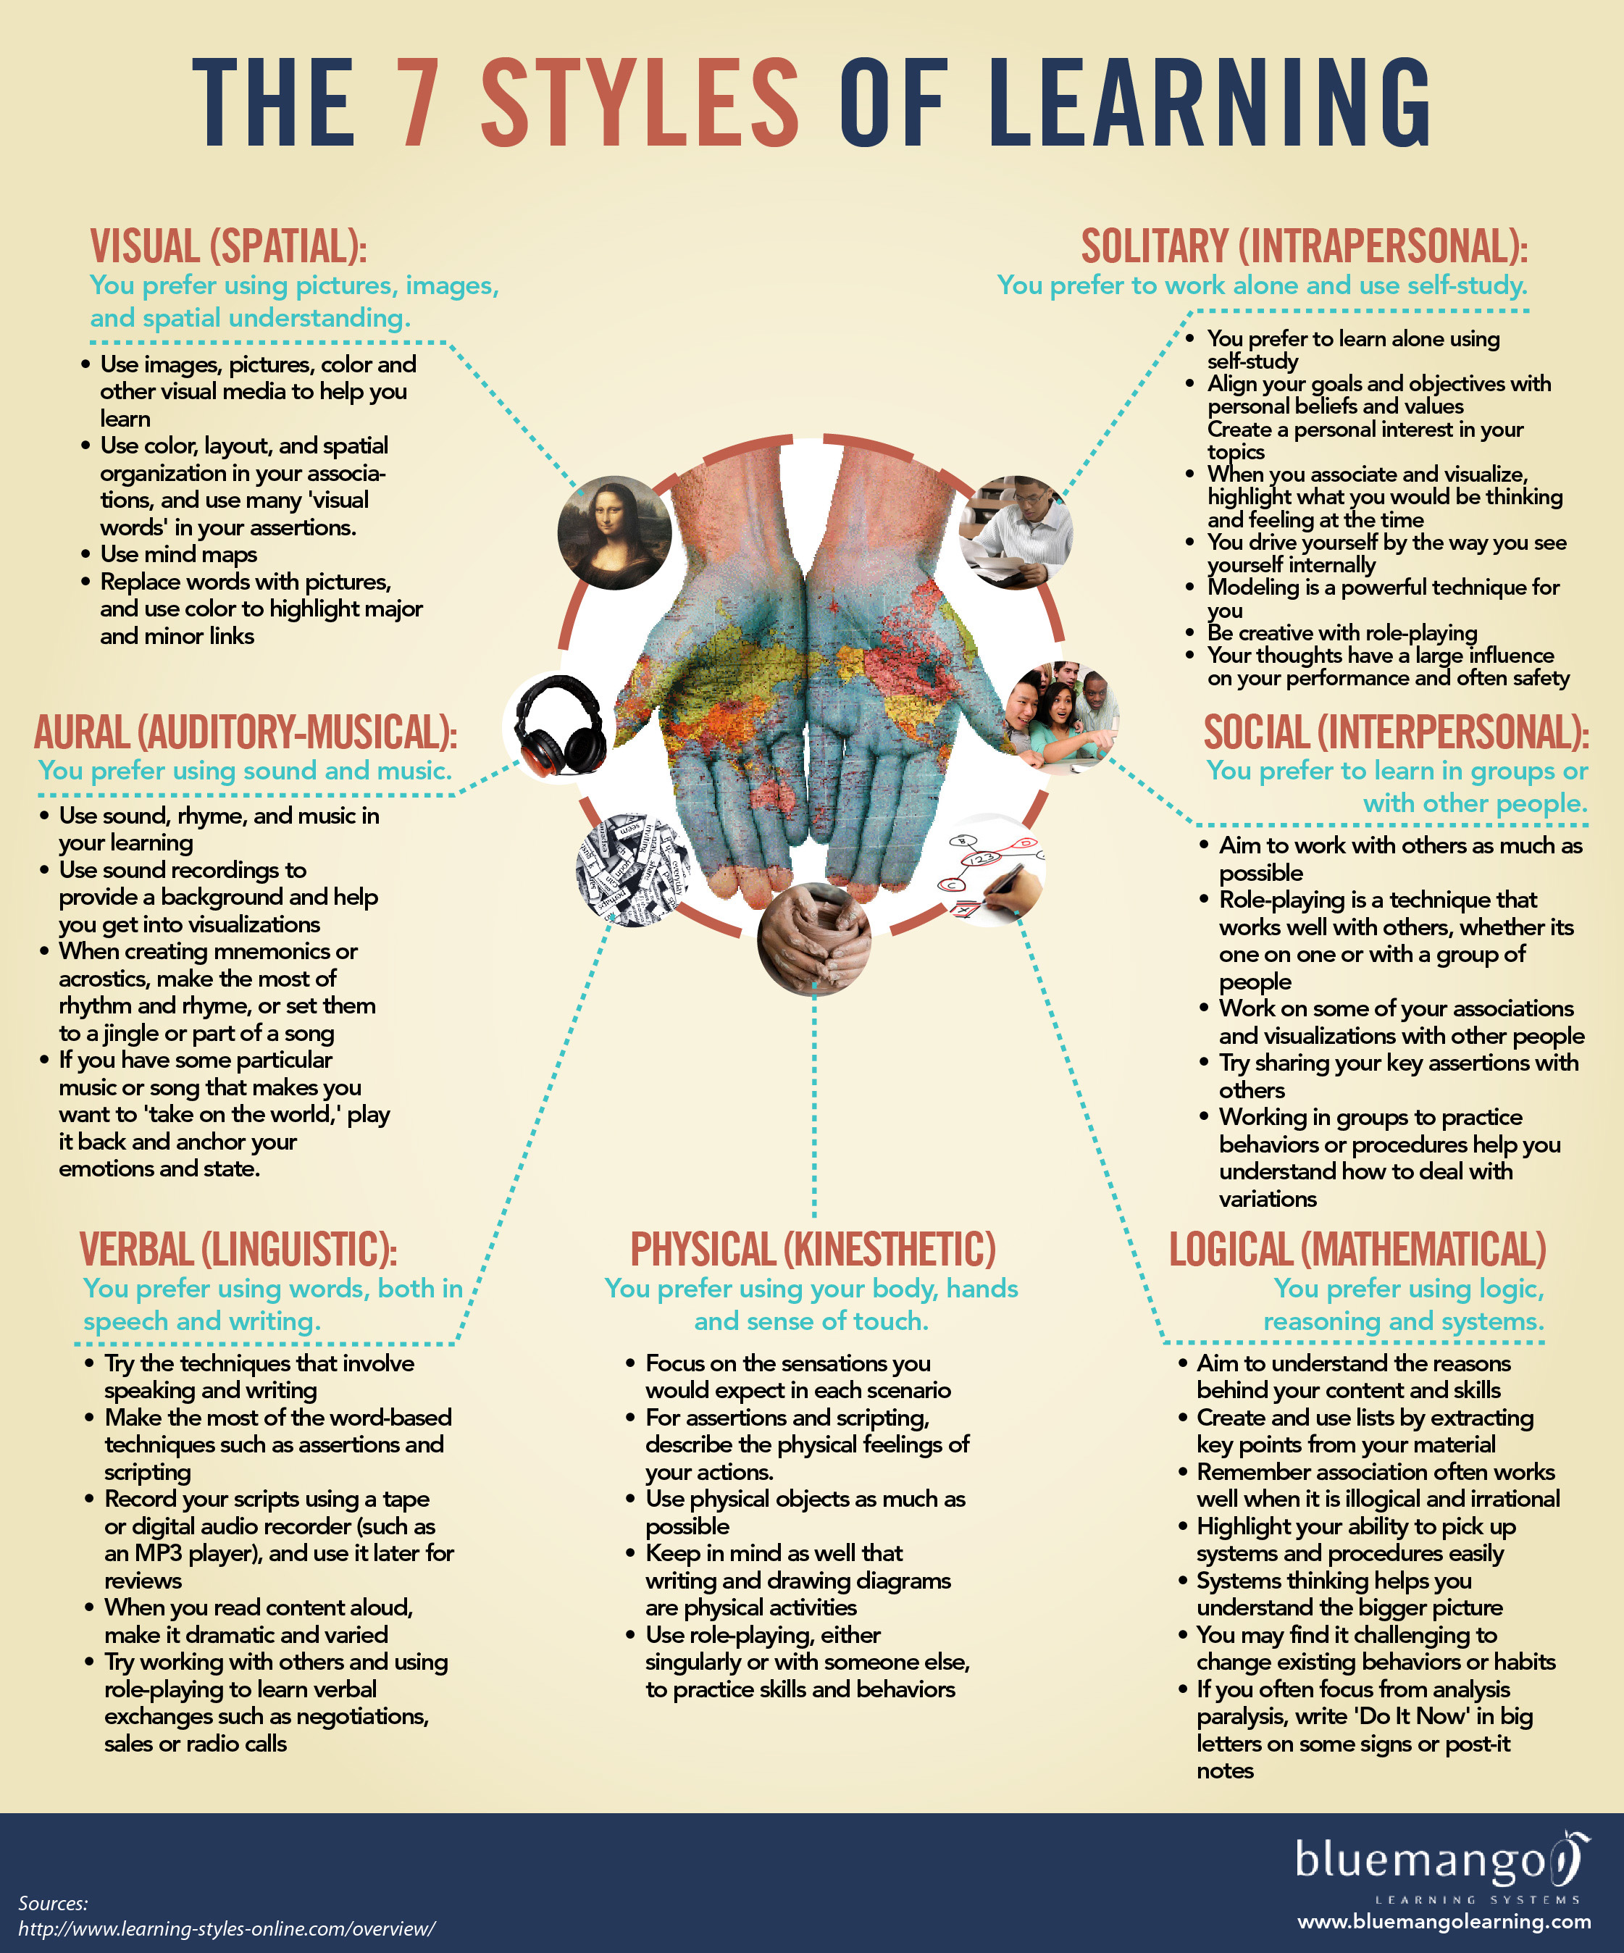
7 styles of learning

Slide 33
Pre-Assessment (kwl)
Know
Want to Know
Learned

Slide 34
Value Accomplishment rather than Attendance
Integrate Positive Classroom Rituals
Adopt Point System / Incentive policy
Praise / Recognize / Award
Use KWL charts
Display Achievement Charts

Slide 35
Teamwork
Supports cooperative learning
Fosters responsibility for each other

Slide 36
Grouping
Grouping is to plan the way your students will interact with you and with each other during activities.

Slide 37
Types of grouping
The whole class working together with the teacher
The whole class mixing as individuals
Small groups of 3+ individuals
Pairs
Individual work

Slide 38
Small groups
Homogeneous
Flexible
Cooperative

Slide 39
Cooperative Grouping
Each group has students of different levels.
Students should never find out their own level.
Stronger students guide weaker students.

Slide 40

Intermediate
Low
High
Intermediate
High
Low

Slide 41
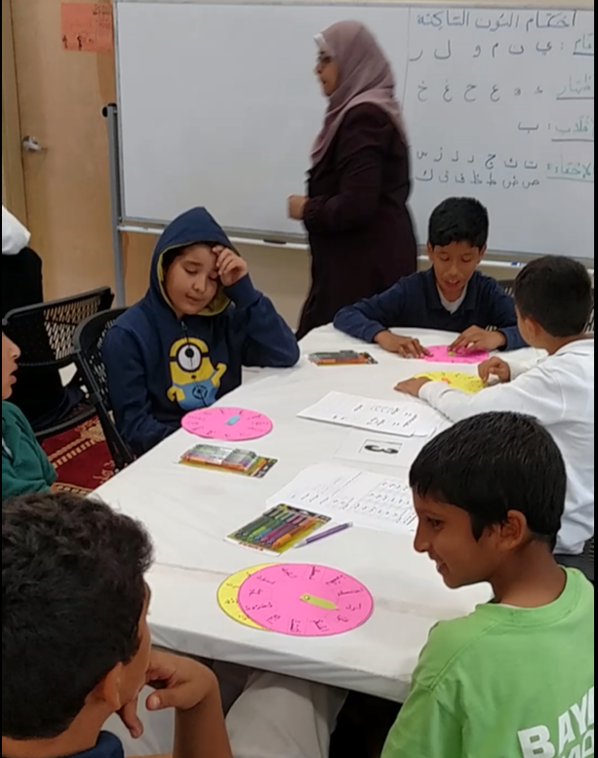
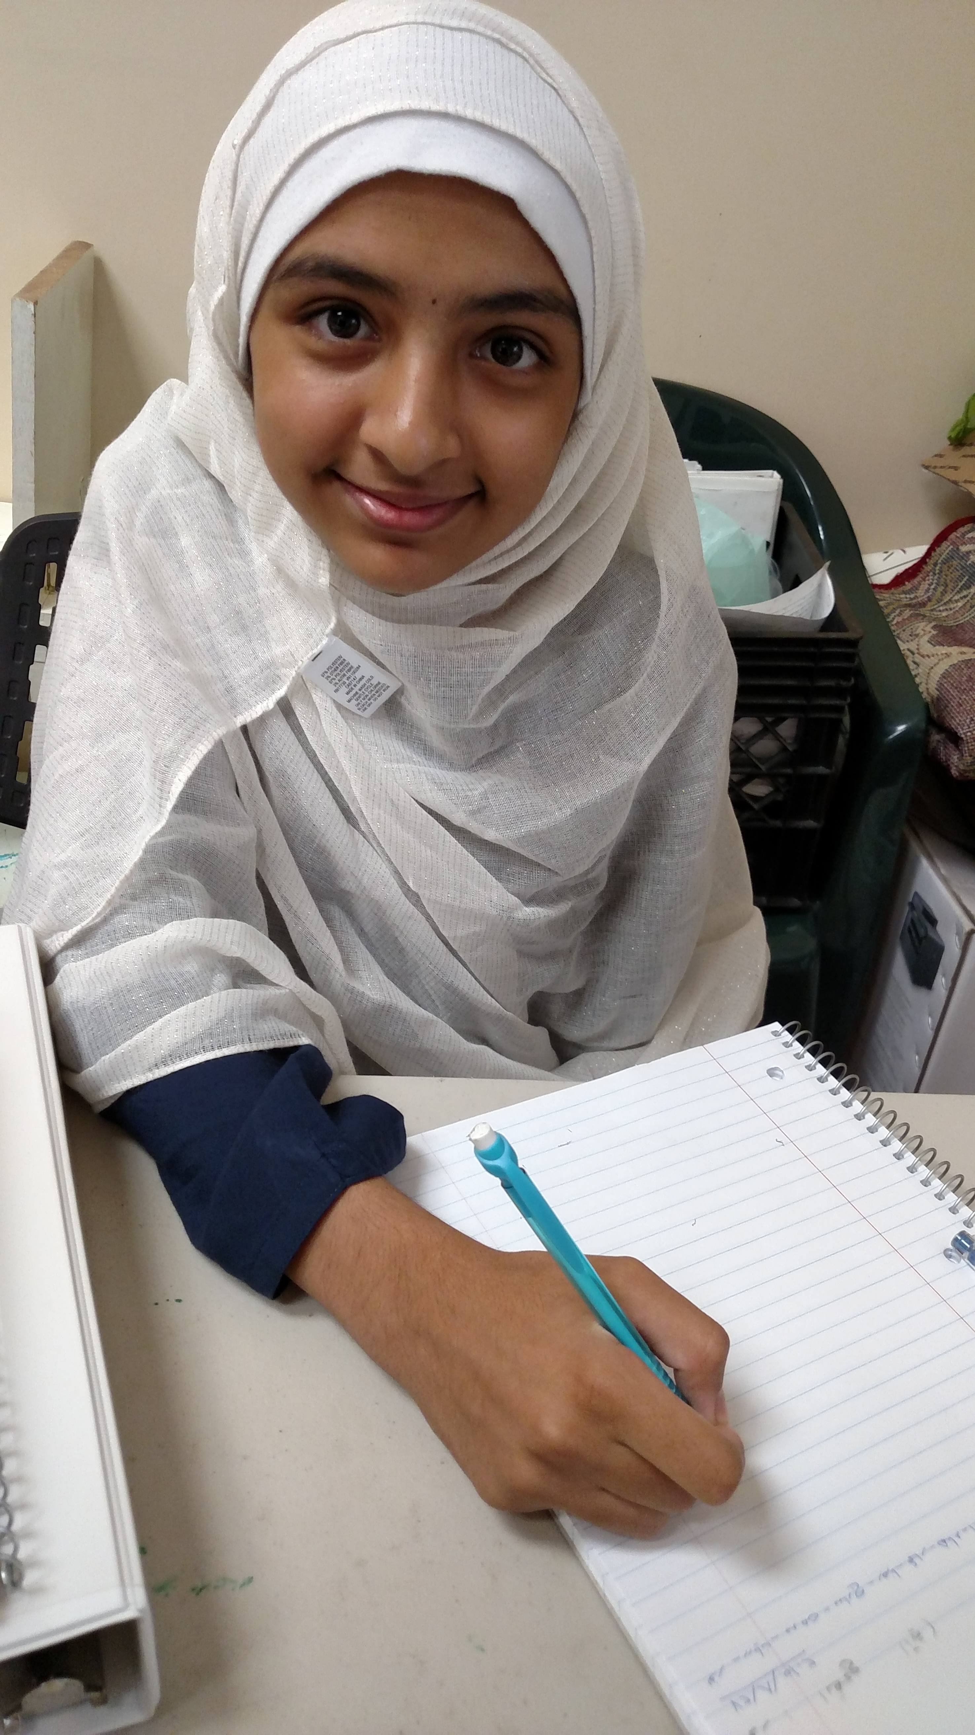
Grouping
Flexible Pairs:
Tajweed Spinners
Individual:
Written assignment

Slide 42
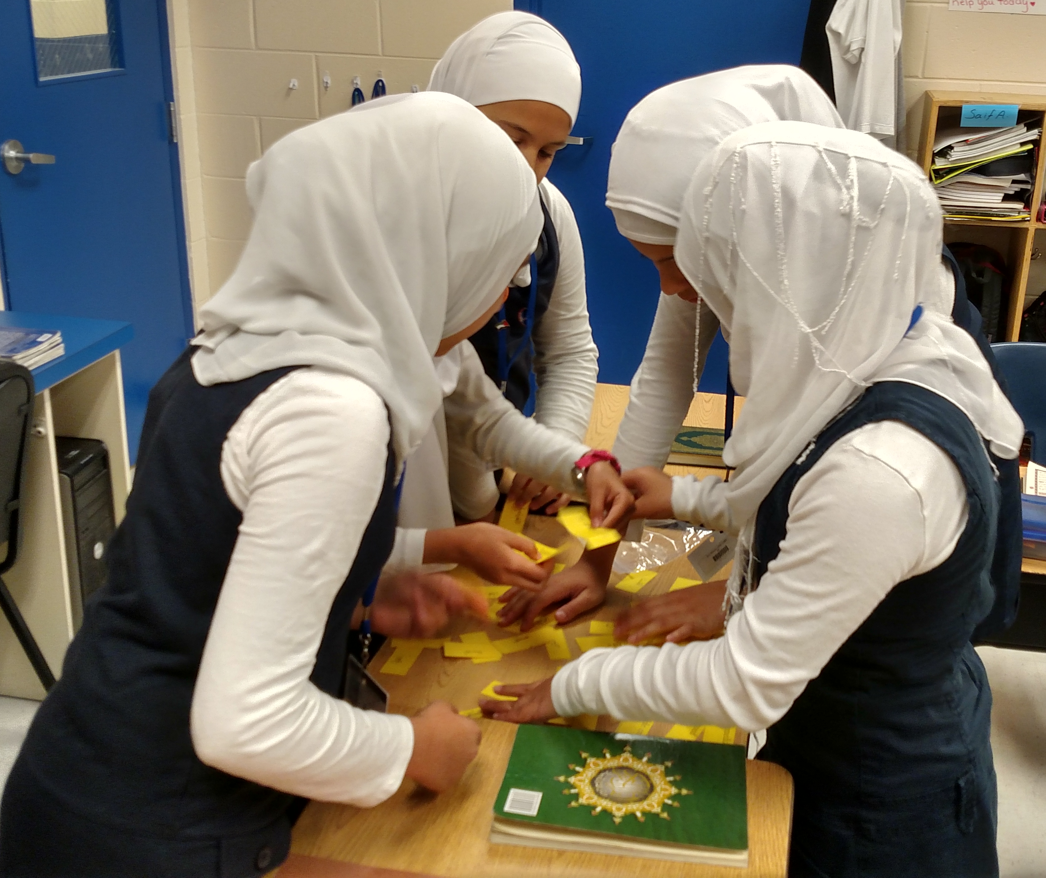
Small Group: Rules of Lam

Slide 43
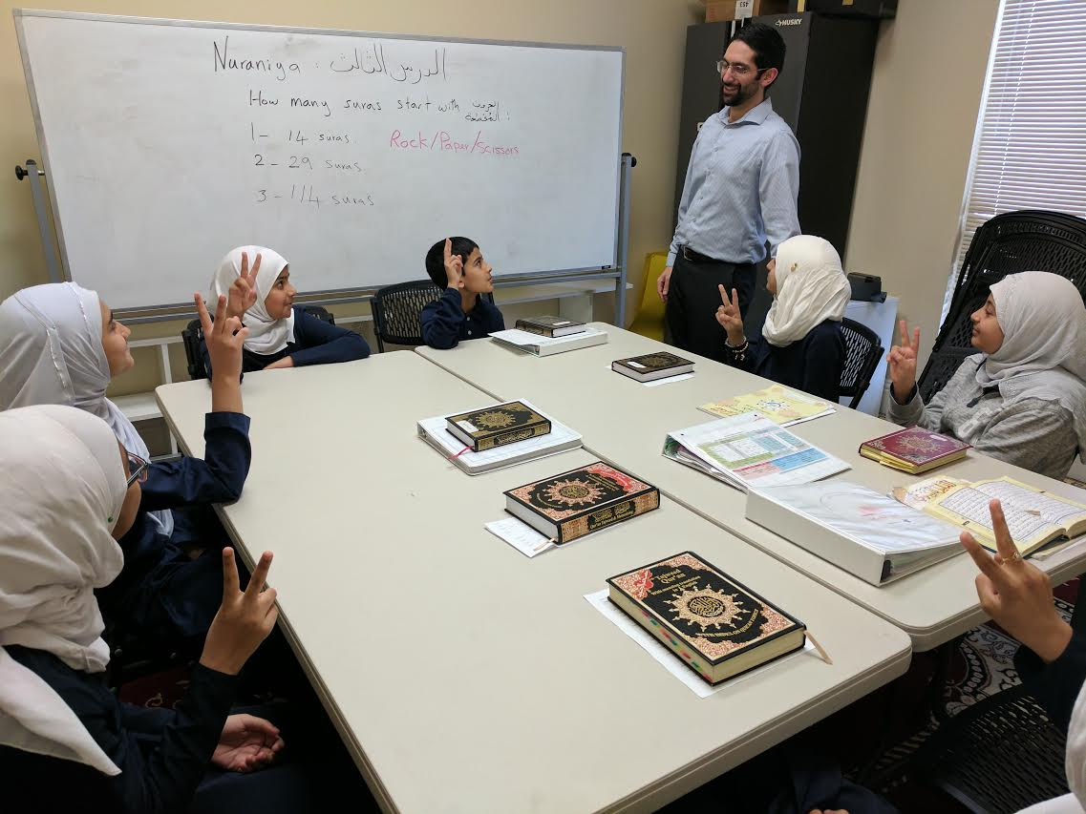
Class: Rock-Paper-Scissors

Slide 44
The teacher

Slide 45
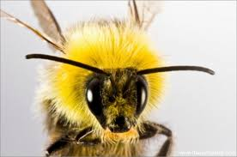
Set and teach class rules
Explain and practice class routine
Clearly communicate expectations
Bee consistent.
Prepared

Slide 46
The Big
5
Build Community
Establish Rules & Procedures
-Plan
-Be Prepared
-Manage Time
-Engage
-Differentiate
-Praise -Respect
-Motivate

Slide 47

Use cues

Slide 48
Get the most out of questions
Use cold calling (along with hand raising)
Don’t call on the same students
Apply Waiting Time 1 and 2

Slide 49
Planning your lesson

Slide 50
Age + 2 or 3
If the age of the student is 7 years,
the maximum continuous instruction should be 9 or 10 minutes

Slide 51


Slide 52

Lesson time distribution
Introductory Activity
Instruction Time
Practice Time
Instruction Time 2 (Recap)
Formative Assessment

Slide 53
Introductory Activity

Slide 54
Instruction

Slide 55
Practice Time

Slide 56
Instruction 2 (Recap)

Slide 57
Formative Assessment- Exit Ticket

Slide 58
Foster:
Critical Thinking
Real Life Experiences

Slide 59
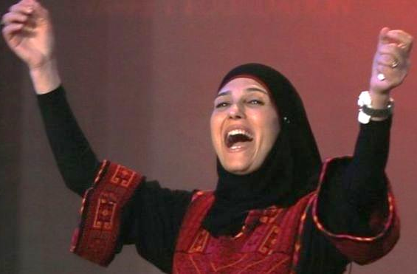
teaching inspiration
Whole Brain Teaching
Teach Like
a Champion

